Slide 1
MIRANDA
Project overview
Matteo Repetto, CNR
Project Coordinator

Slide 2
Project factsheet
Started: 1st September 2024
Duration: 36 months
Budget: 7 308 925.00 €
14 partners
3 Use Cases
  Wolfsburg, Genoa, Athens
Notes:
The MIRANDA project started on 1st September 2024 and will run for 3 years. With a budget of more than 7 millions euros and 14 partners, the Consortium will validate and demonstrate its technologies in 3 Use Cases in Wolfsburg, Genoa, and Athens. Both are smart cities applications made of multiple services and infrastructures. MIRANDA explicitly addresses the needs for security in multi-domain and multi-ownership systems, like those you can build with FIWARE technologies. This is why I’m here today to introduce you the MIRANDA project, and I hope we can feed a continuous dialogue during and even after this project.

Slide 3
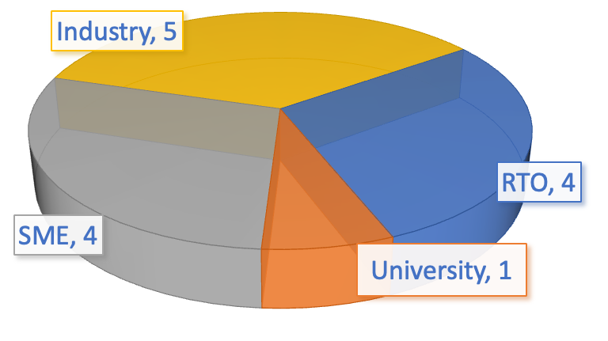
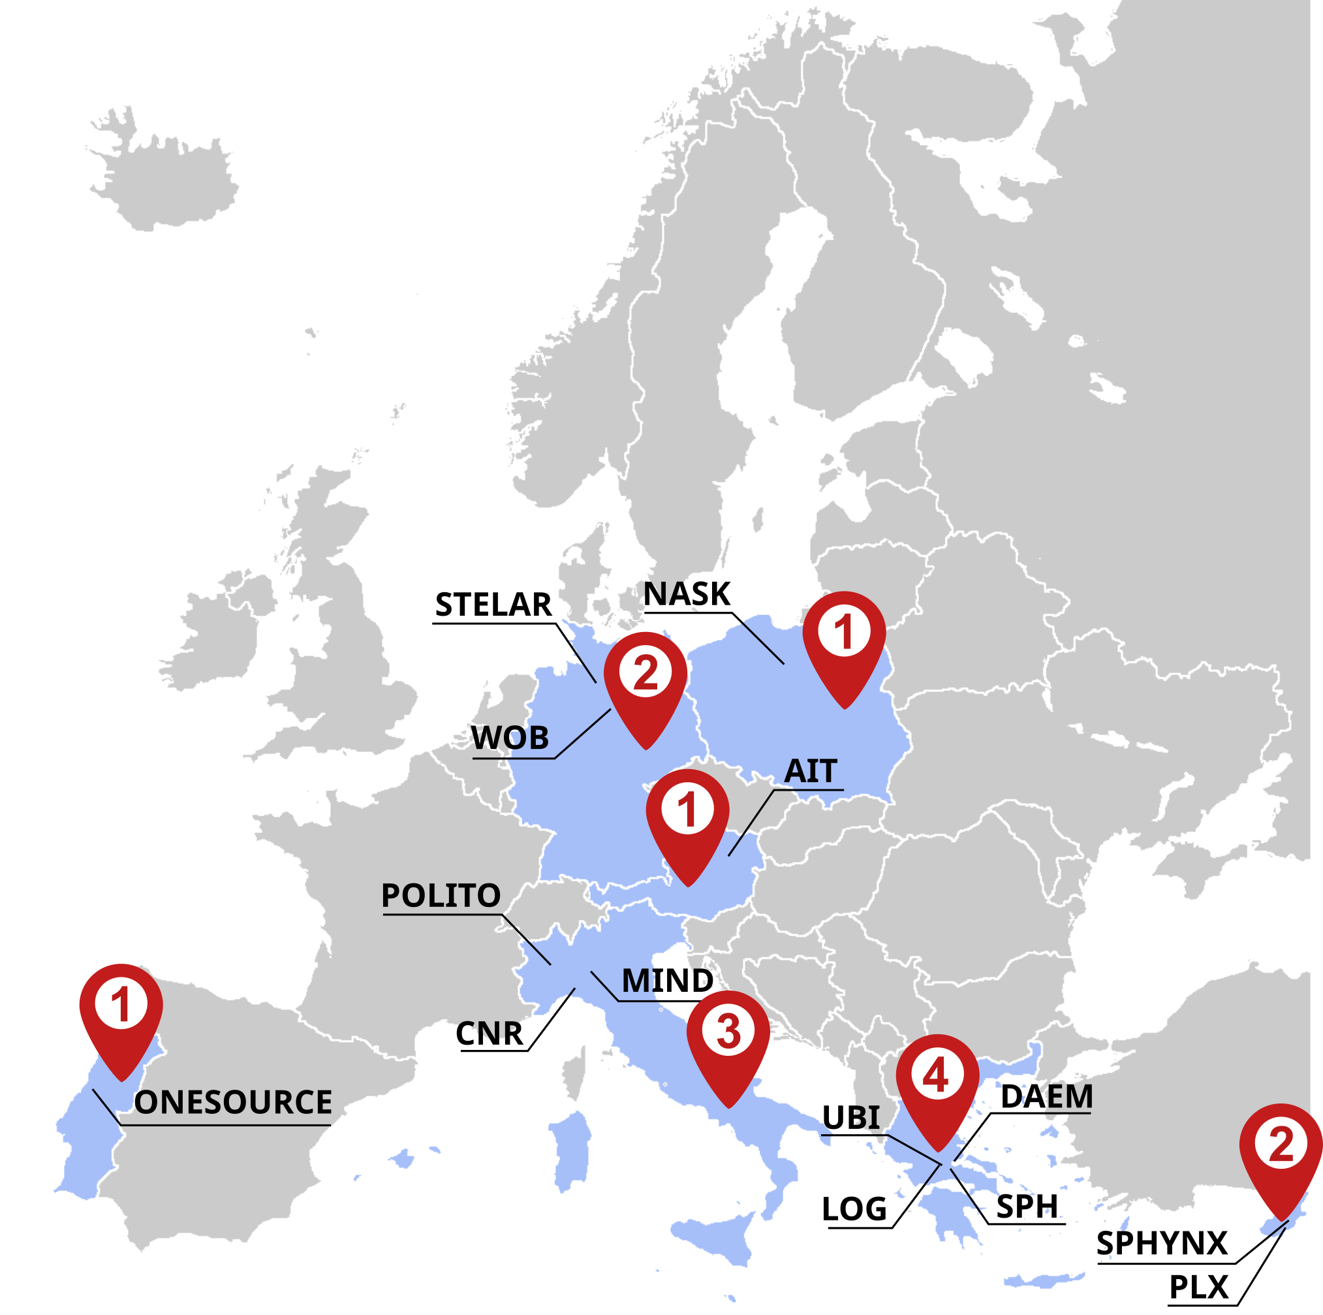
Consortium
No | Participant Organisation Name | Short Name | Type | Country
01 | CONSIGLIO NAZIONALE DELLE RICERCHE | CNR | RTO | IT
02 | SPACE HELLAS | SPH | Industry | EL
03 | ONESOURCE | ONE | SME | PT
04 | STELAR | STELAR | RTO | DE
05 | LOGSTAIL | LOG | SME | EL
06 | POLITECNICO DI TORINO | POLITO | University | IT
07 | NAUKOWA I AKADEMICKA SIEC KOMPUTEROWA - PAŃSTWOWY INSTYTUT BADAWCZY | NASK | RTO | PL
08 | AIT - AUSTRIAN INSTITUTE OF TECHNOLOGY GmbH | AIT | RTO | AT
09 | SPHYNX | SPHYNX | Industry | CY
10 | PLAIXUS | PLX | SME | CY
11 | UBITECH | UBI | SME | EL
12 | WOBCOM GmbH | WOB | Industry | DE
13 | MINDICITY | MIND | Industry | IT
14 | DIMOS ATHINAION EPICHEIRISI MICHANOGRAFISIS | DAEM | Industry | EL
Notes:
The MIRANDA project started on 1st September 2024 and will run for 3 years. With a budget of more than 7 millions euros and 14 partners, the Consortium will validate and demonstrate its technologies in 3 Use Cases in Wolfsburg, Genoa, and Athens. Both are smart cities applications made of multiple services and infrastructures. MIRANDA explicitly addresses the needs for security in multi-domain and multi-ownership systems, like those you can build with FIWARE technologies. This is why I’m here today to introduce you the MIRANDA project, and I hope we can feed a continuous dialogue during and even after this project.

Slide 4



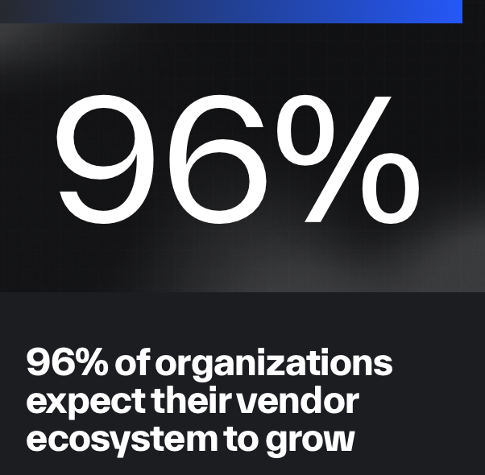
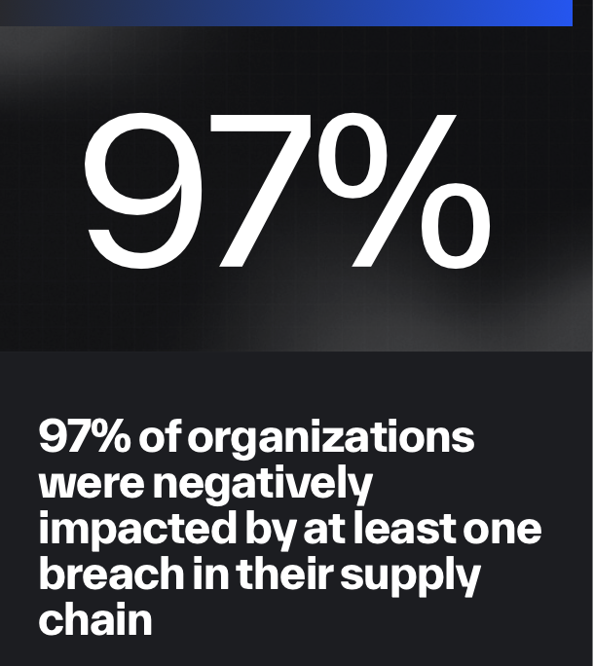
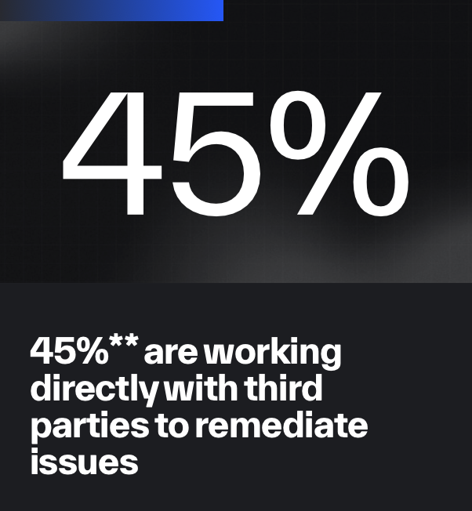
Motivations
Digital services and connectivity
Bluevoyant, The State of Supply Chain Defense – Annual Global Insights Report 2025
Service vs supply chain
Operation vs Development scope

Slide 5
Motivations
Beyond NIS2 – Proactive and collaborative approach
Identification of suppliers
  Manual registration and yearly update
  Narrow scope
Hub and spoke topology
  operators of critical and essential services
Reactive/static/fragmented approach
  Cyber-incidents notification
  Cyber-security obligations
  Risk management
* Analysis based on the NIS implementation by ACN in Italy
Notes:
Dynamic nature of service chains
Be proactive, dynamic, and semi-autonomous at the same time (no static security measures a priori)

Slide 6



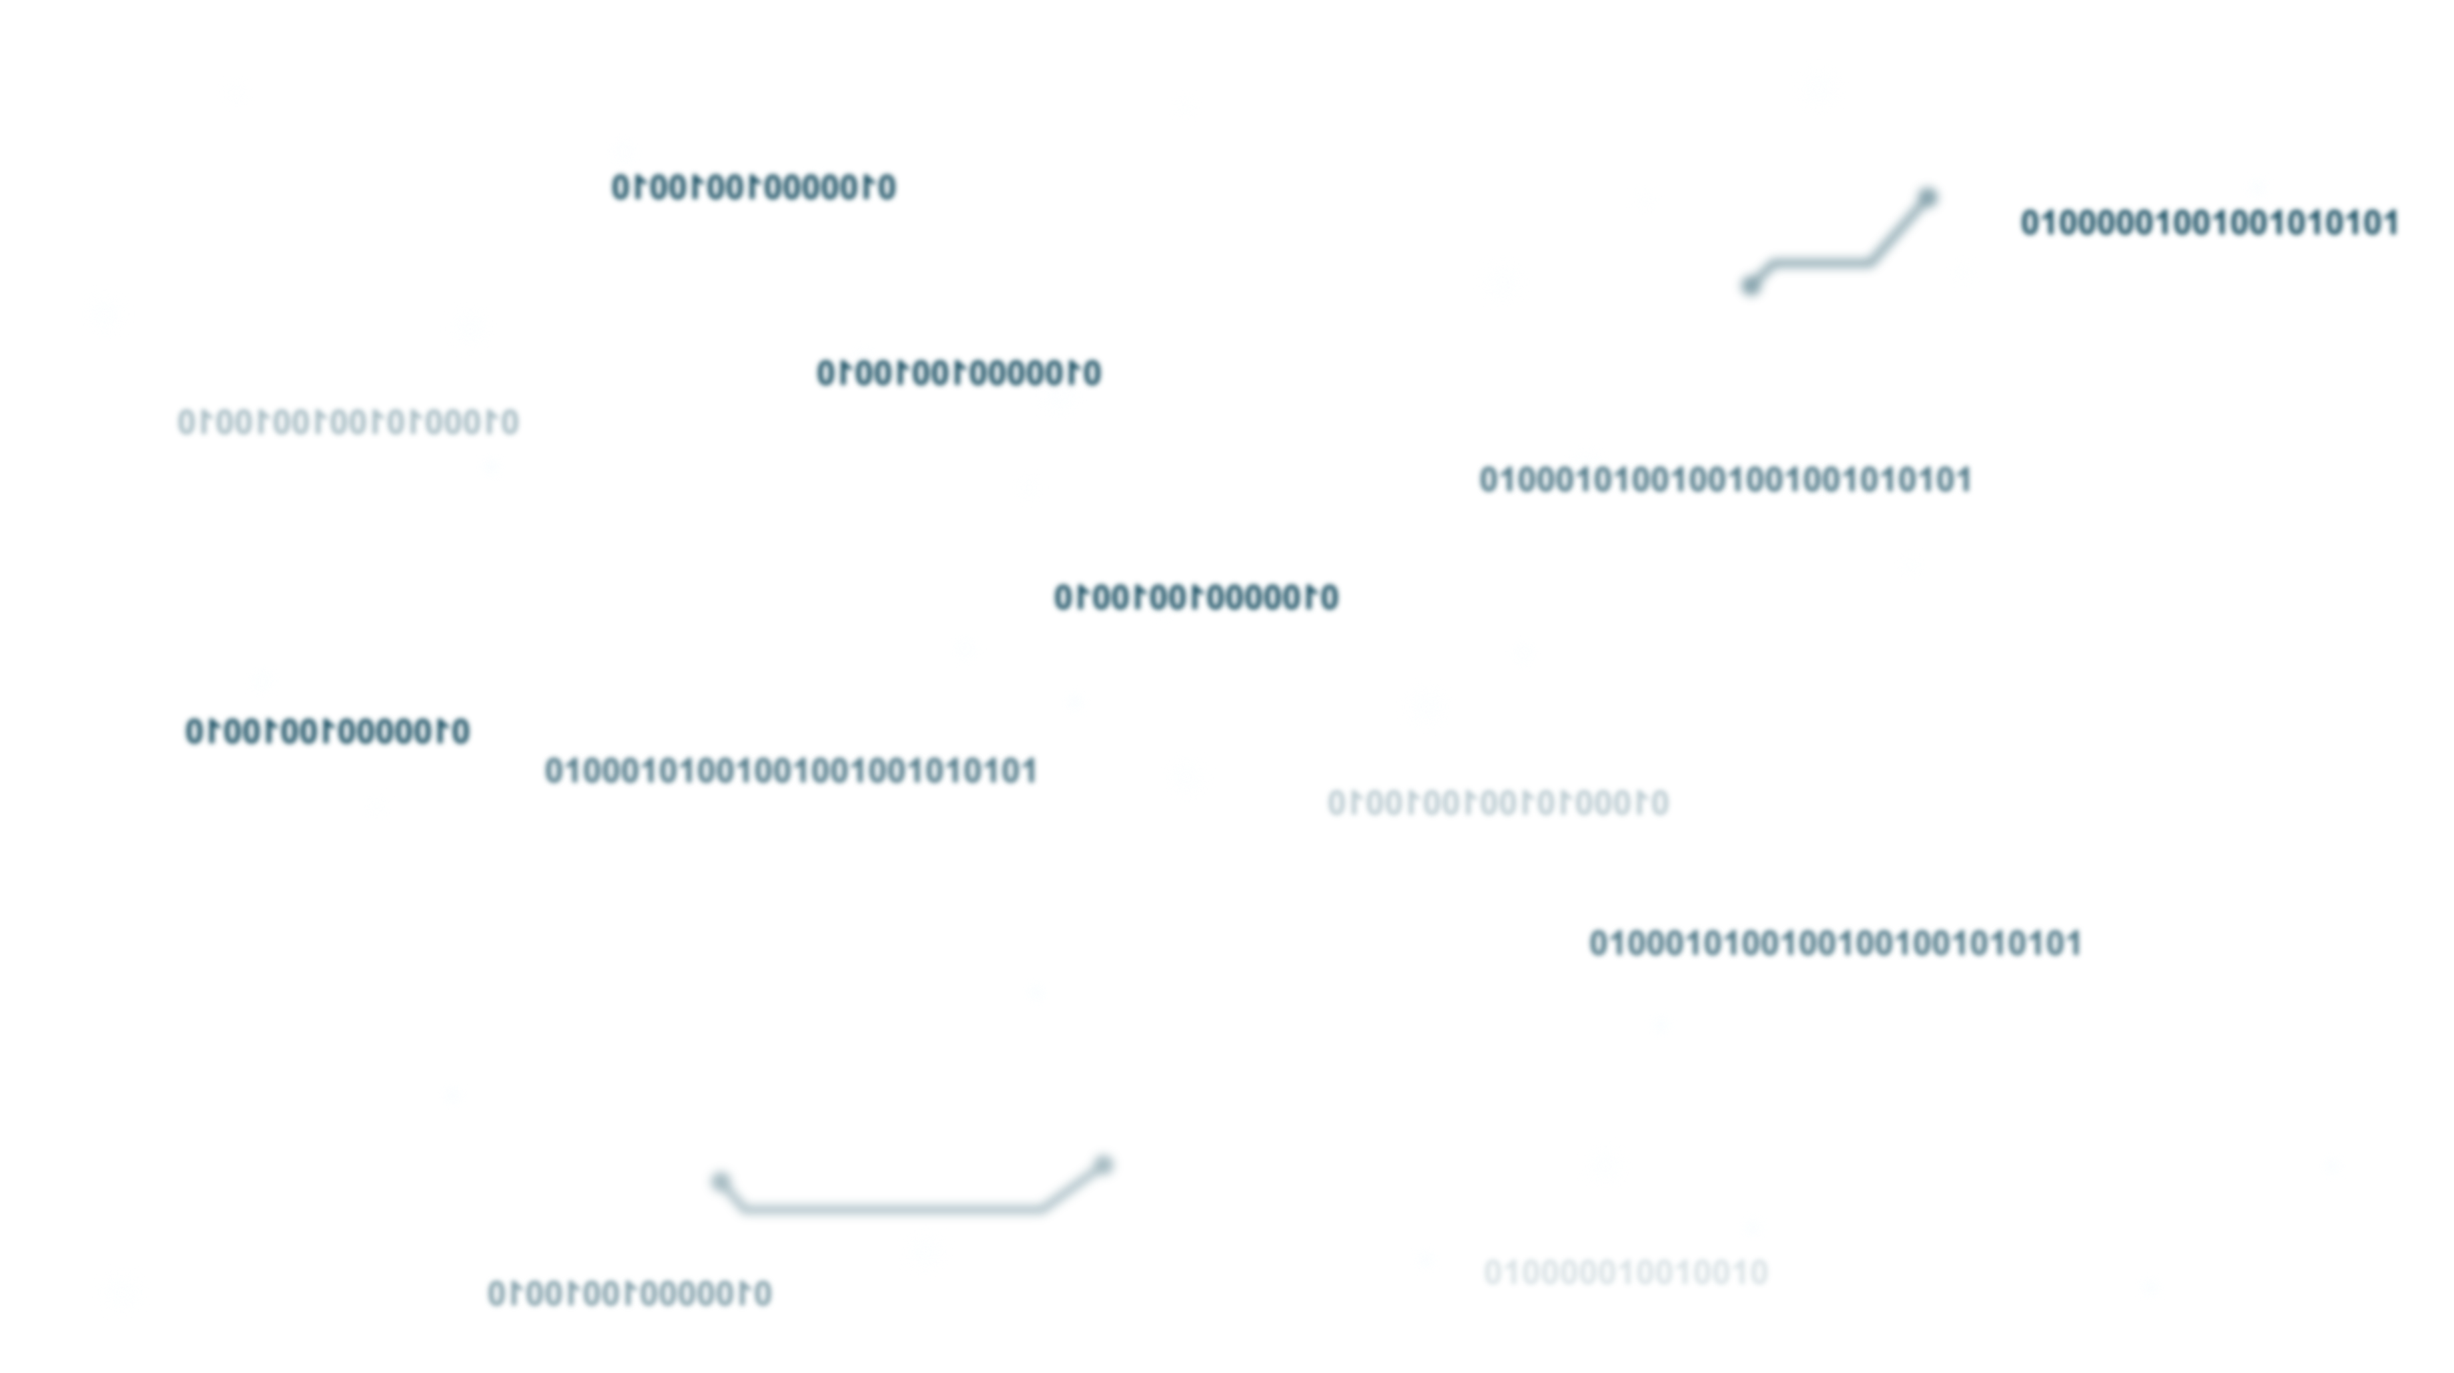
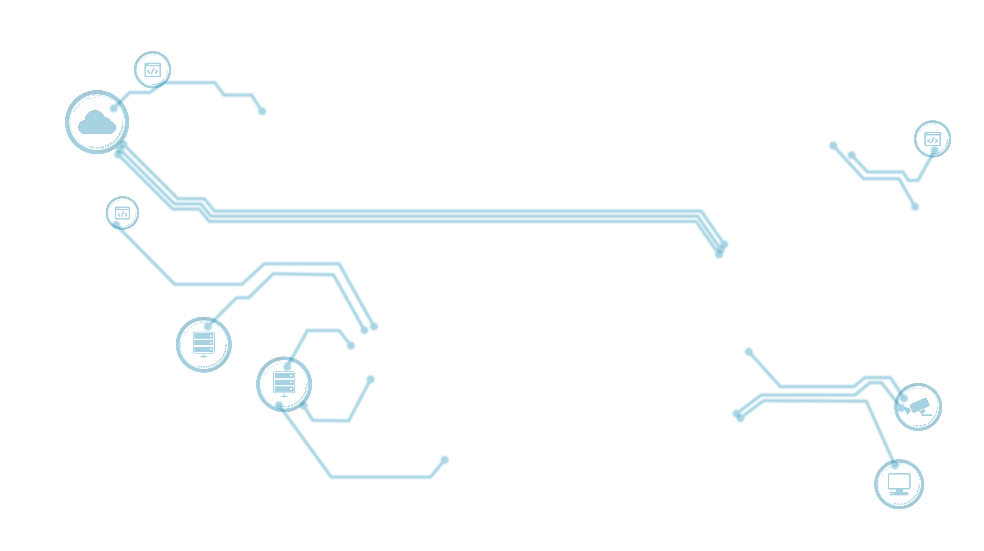
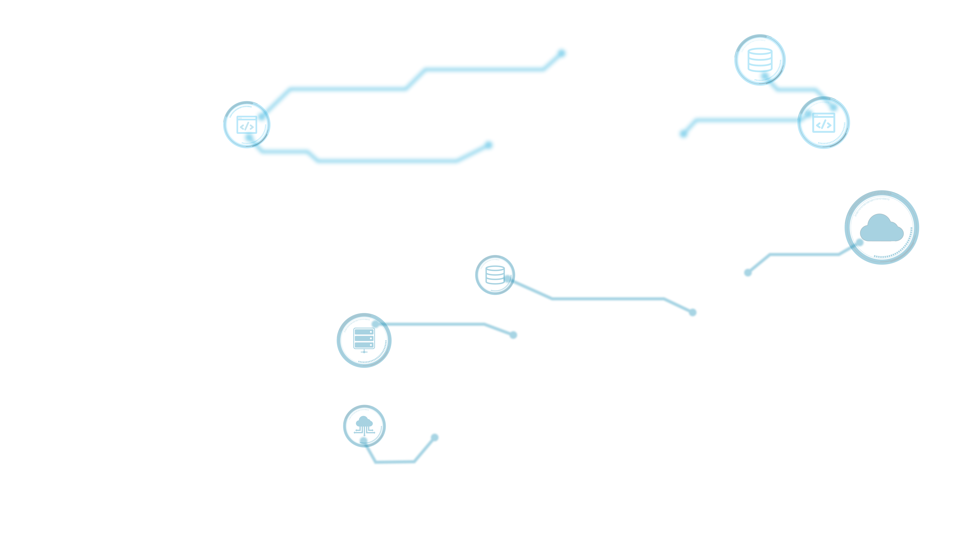


Concept
Building Cyber-security Digital Twins
Notes:
A sort of digital twin for the propagation of cyber-threats and vulnerabilities
abstraction of the underlying context (service chain)
threat analysis and prediction

Slide 7
Concept
Building Cyber-security Digital Twins
Cyber-security Digital Twin:
  Understand and proactively predict the propagation of attacks
  Explore alternative configurations before their deployment
  Automate data collection and processing
Collaborative cyber-security operations
  Automate mitigation and response
  Improve CTI management
  Enhance risk assessment
  Threat hunting

Slide 8
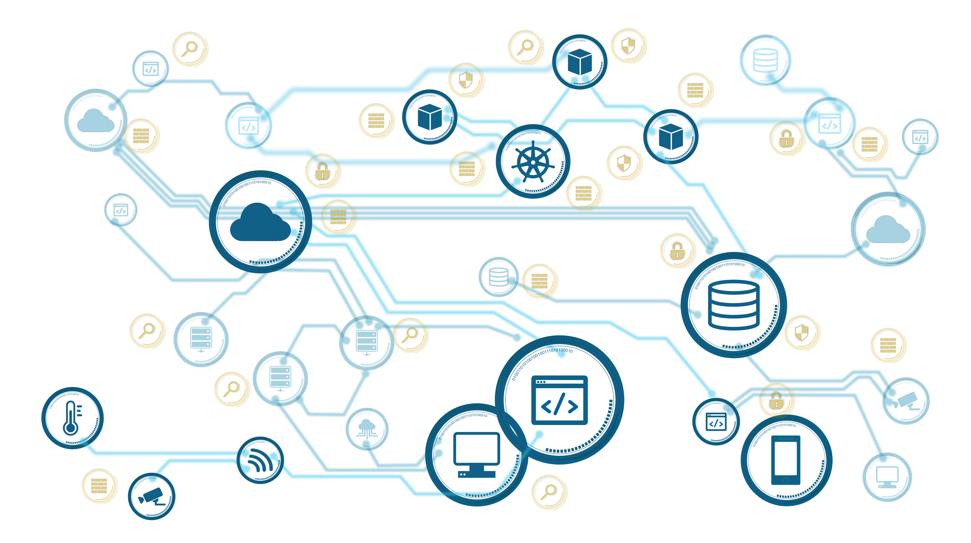
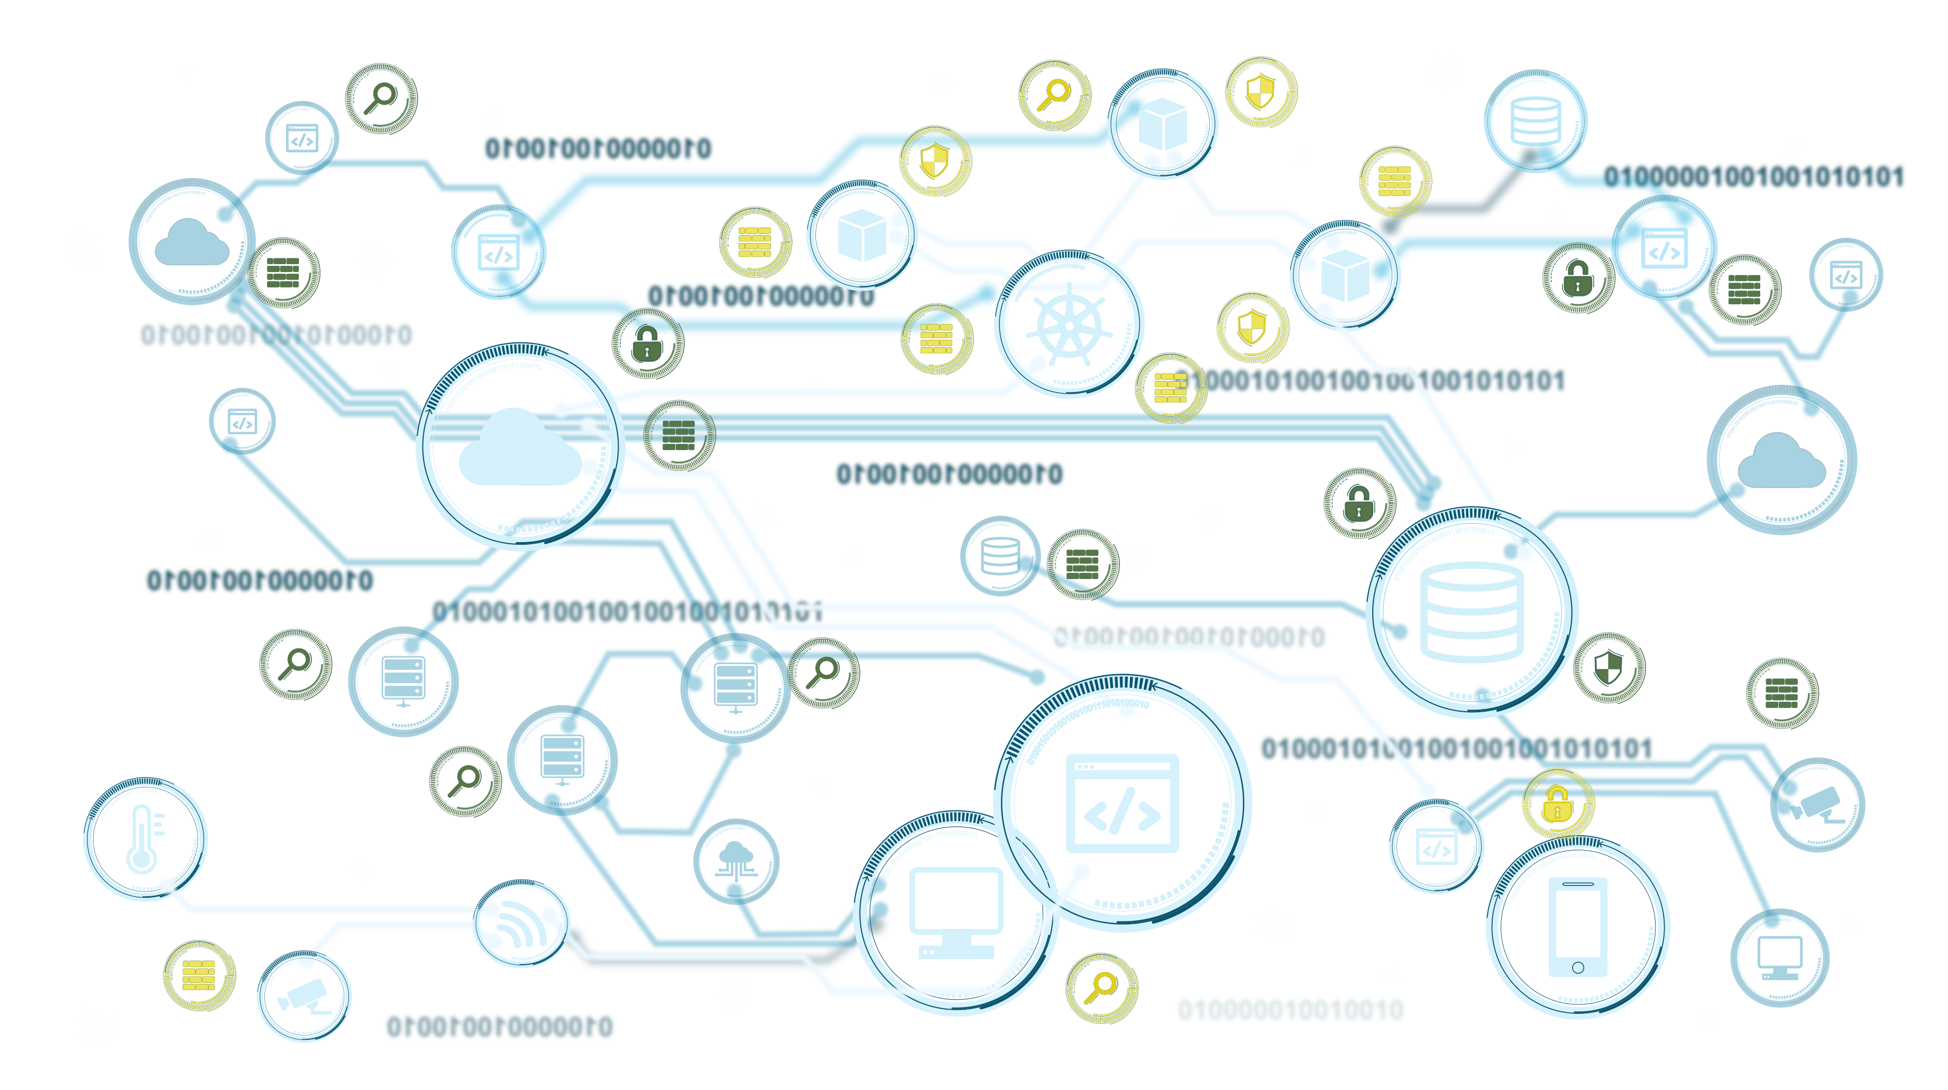
Concept
Building Cyber-security Digital Twins

Slide 9
Concept
Value proposition
Proactive
  Threat propagation, Threat hunting, Prediction, Sandboxing
Pervasive
  Cross-domain, Cross-technology xBOM and Controls
Adaptive
  Dynamic parser generation, context-aware response, Threat Intelligence

Slide 10
Concept
Capabilities
Monitoring
  xBOM
  log files, network flows, (system metrics, security applications)
Detection
  ML/AI-driven
Hunting
  Model-based anticipation
Response
  LLM policy derivation
  Automatic configuration derivation

Slide 11
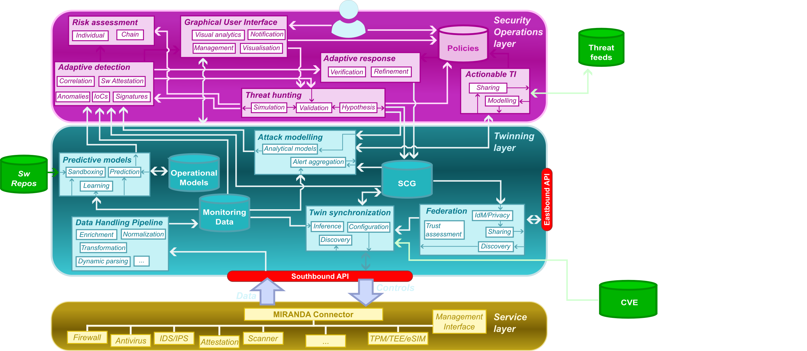
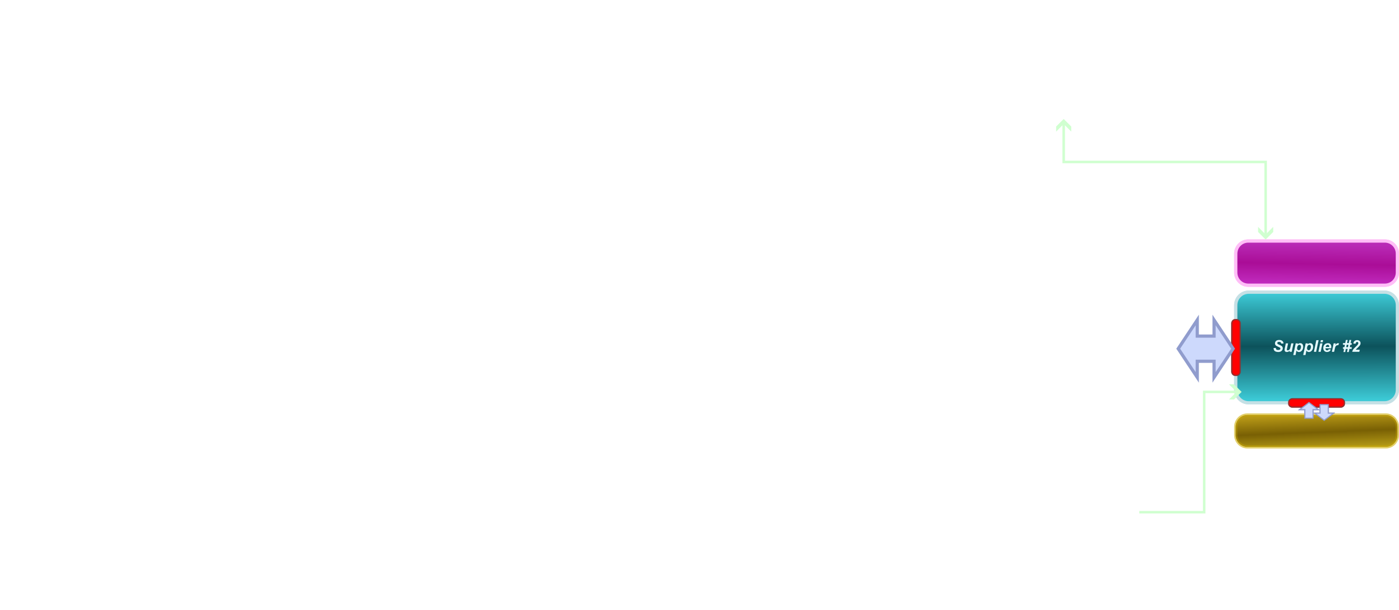
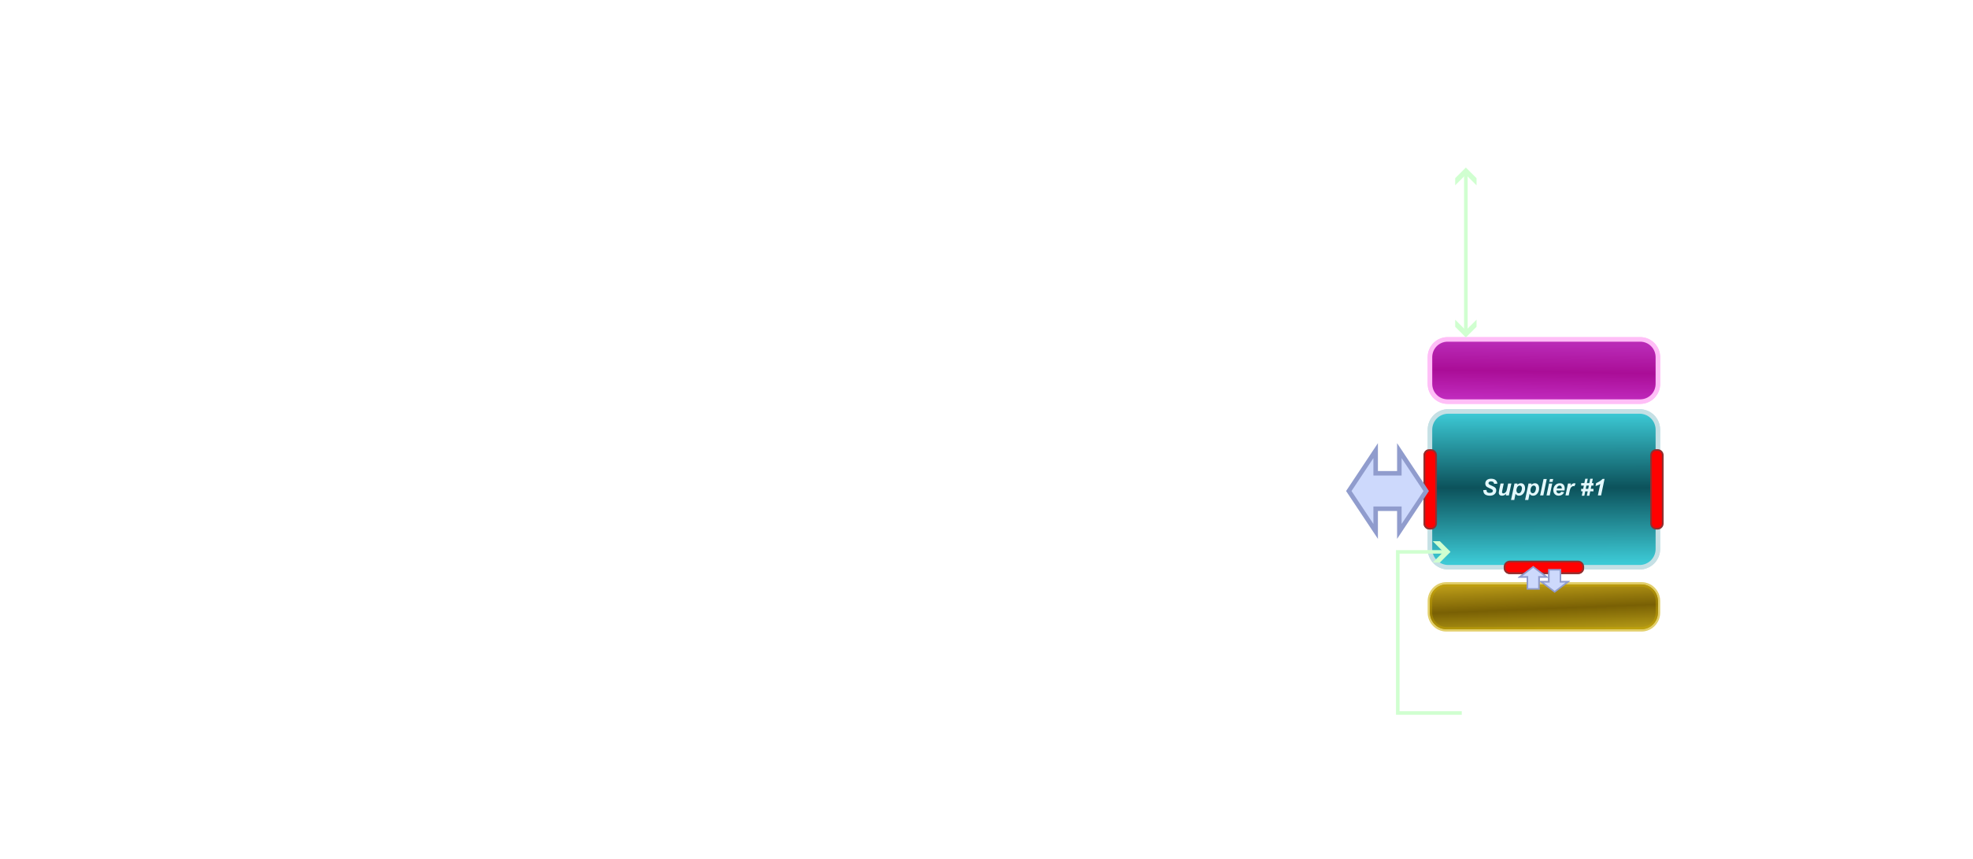
Approach
The MIRANDA framework

Slide 12

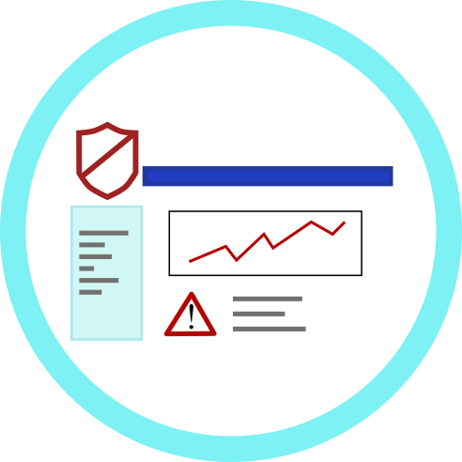








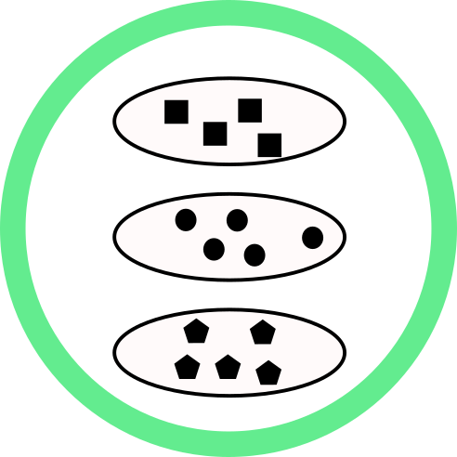







Status
Platform integration
Dashboards
Logstail
MIRANDA
Sphynx SPA
Tools
VEREFOO
CACAO-LLM
Threa Hunting
SAD
Symbolic Log Shield
Threat Sharing API
IoC Extractor
DAA
TAF
AlertBERT
DetectMATE
Connector
DHP
Threat Connector
PATHS
xBOM
nProbe
Logstash
Kibana
Agents
Filebeat
Packetbeat
(Metricbeat)
Parsers
Kafka
Predictor
Sandboxing
fProbe
Models/Simulation
Tracer
Notes:
Agents:
SCG (Cyclone DX) -> OpenStack, Kubernetes, Linux host, File
Filebeat, Packetbeat, nprobe, fprobe
SLPF (iptables, OpenStack, Kubernetes)
eBPF Tracer,
TCB with inherent CIV
Models:
Kibana
Prediction
Sandbox
PATHS
Threat Connector

Slide 13
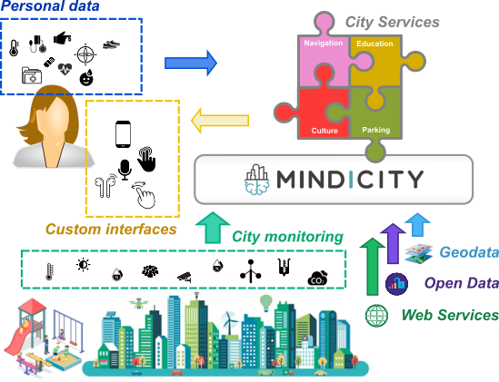
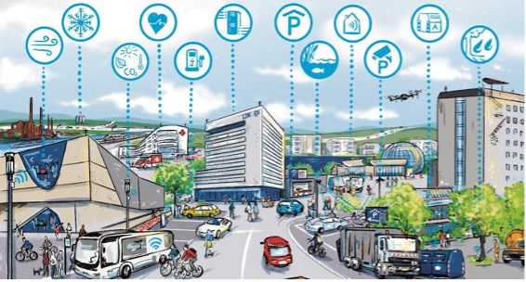
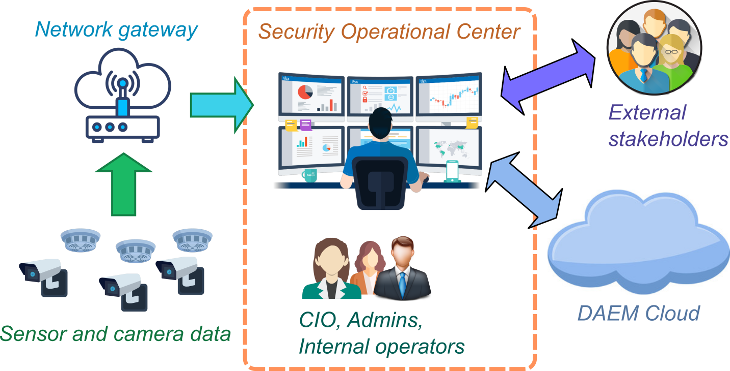
Approach
Use Cases
Wolfsburg, Germany
Genoa, Italy
Athens, Greece
Notes:
Similar structure, but very different implementation

Slide 14







Questions?
info@mirandaproject.eu
www.mirandaproject.eu
https://www.linkedin.com/company/105119663
@mirandaprj
@MIRANDA-Project

