Slide 1
Cyber-security Digital Twins for Security Smart Cities
Matteo Repetto (CNR-IMATI)

Slide 2
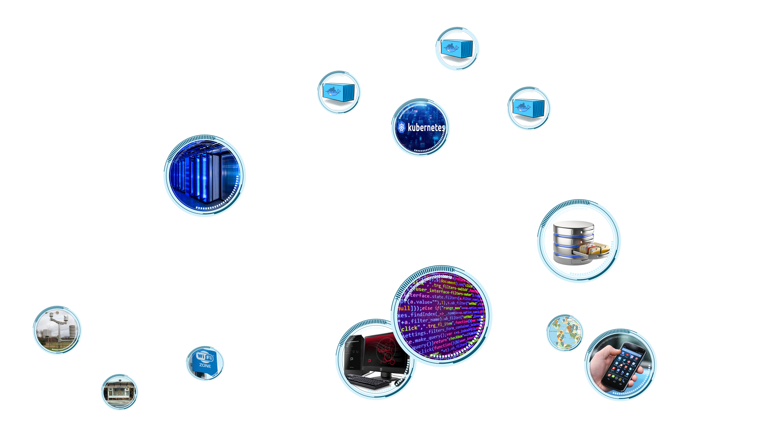
Digitalisation is all around

Slide 3
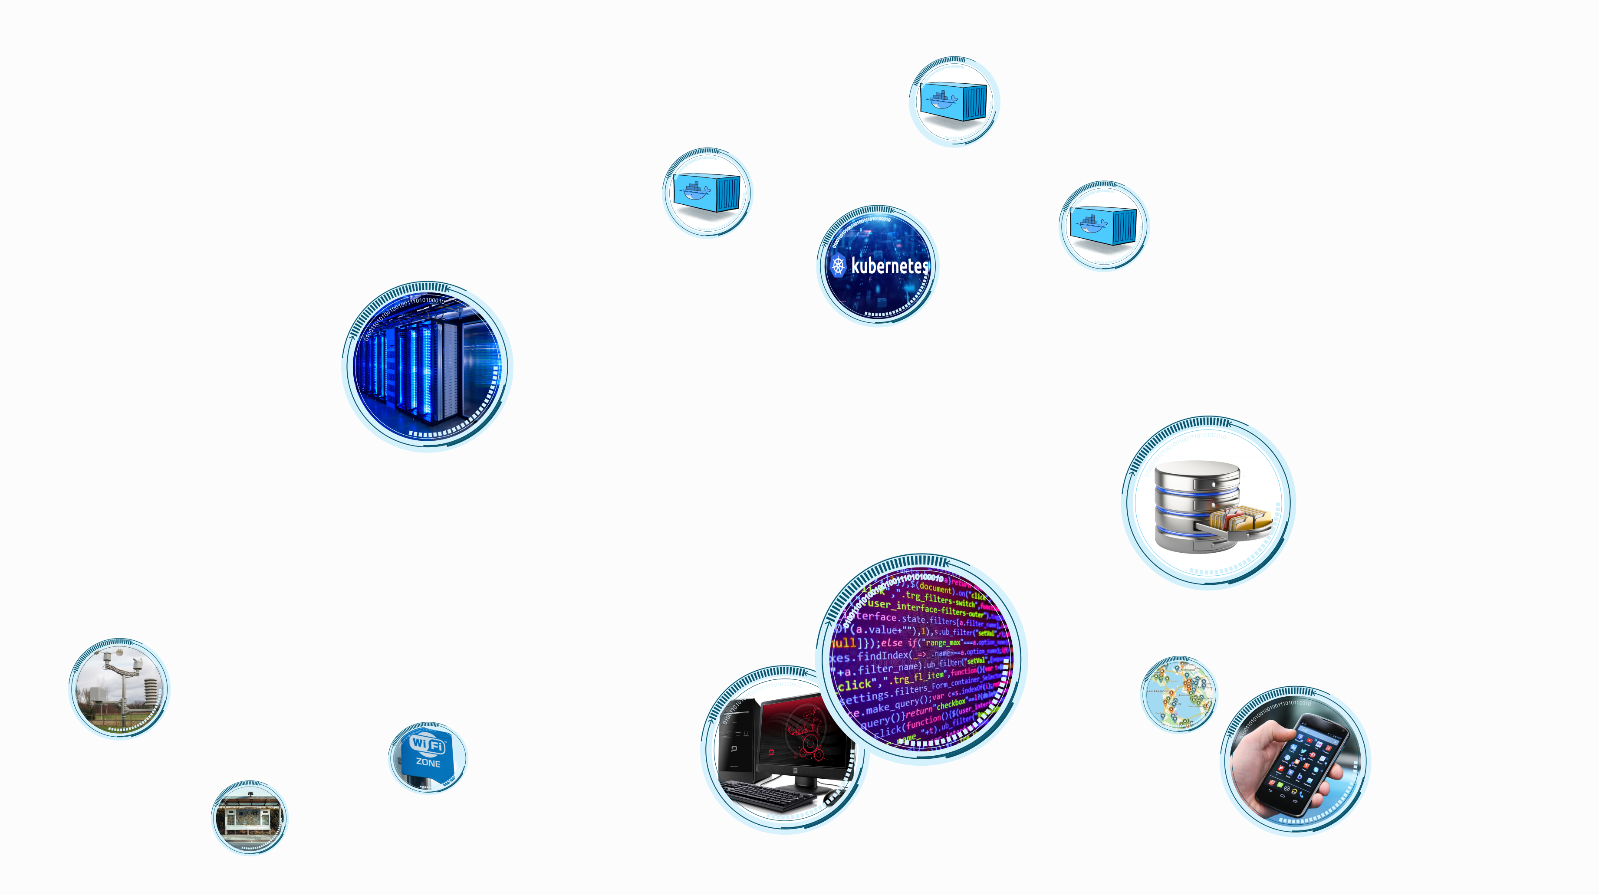
Smart City is digital connectivity

Slide 4
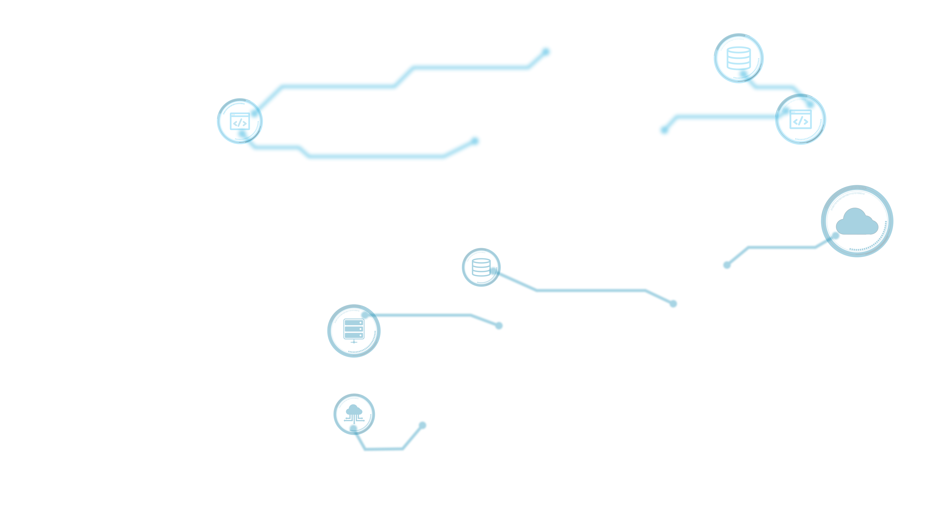
But… what’s behind a service?

Slide 5
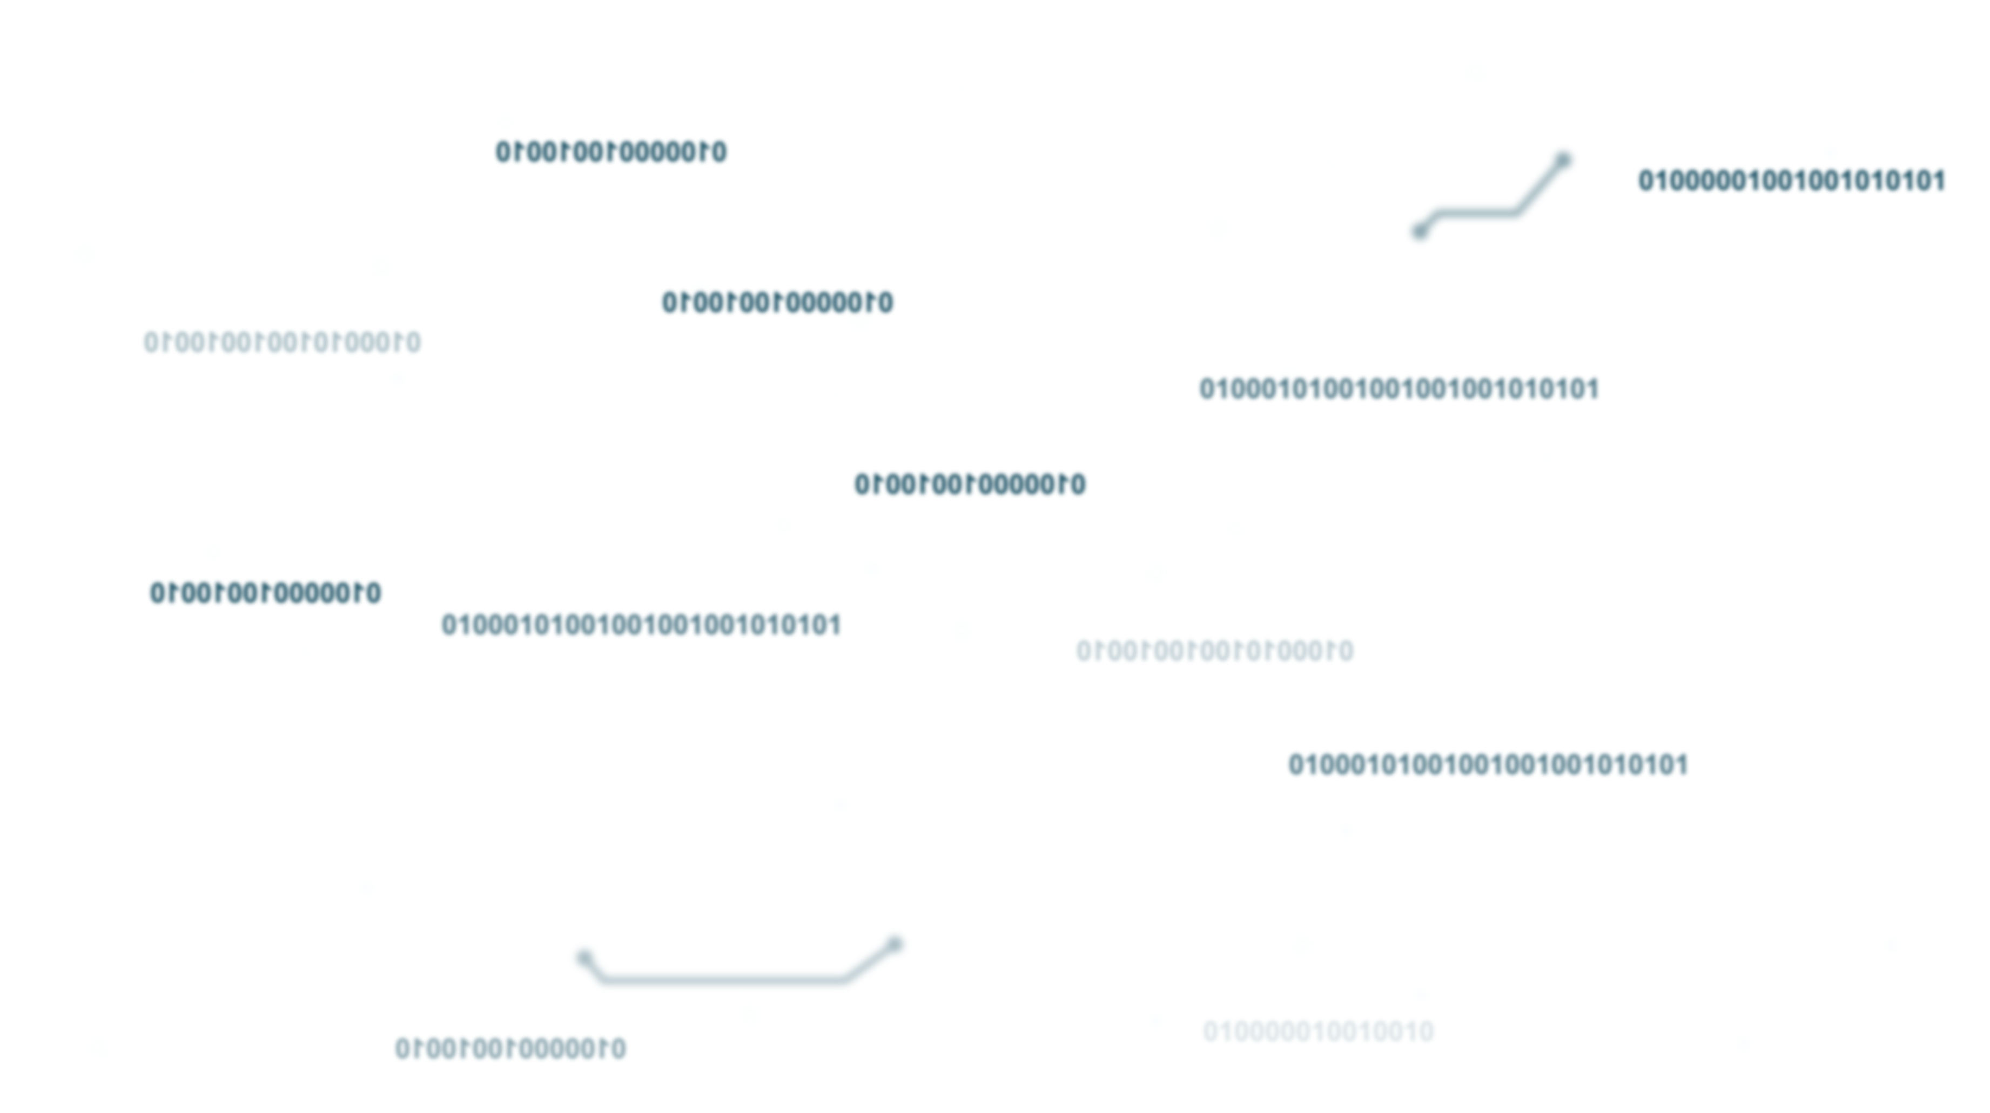
… and even more behind?

Slide 6
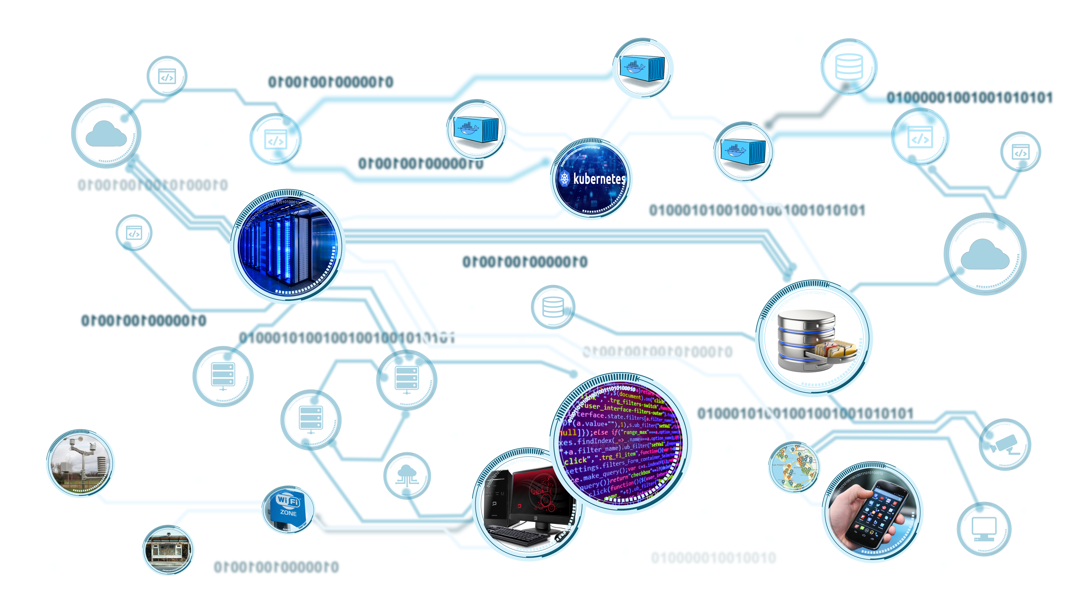
Every chain has its weakest link(s)!

Slide 7
We have security functions in place…

Slide 8
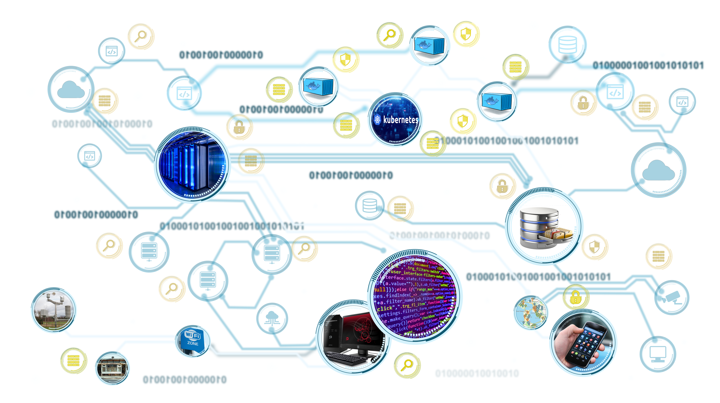
… but do you really trust your suppliers?

Slide 9
A collaborative cyber-security model

Slide 10
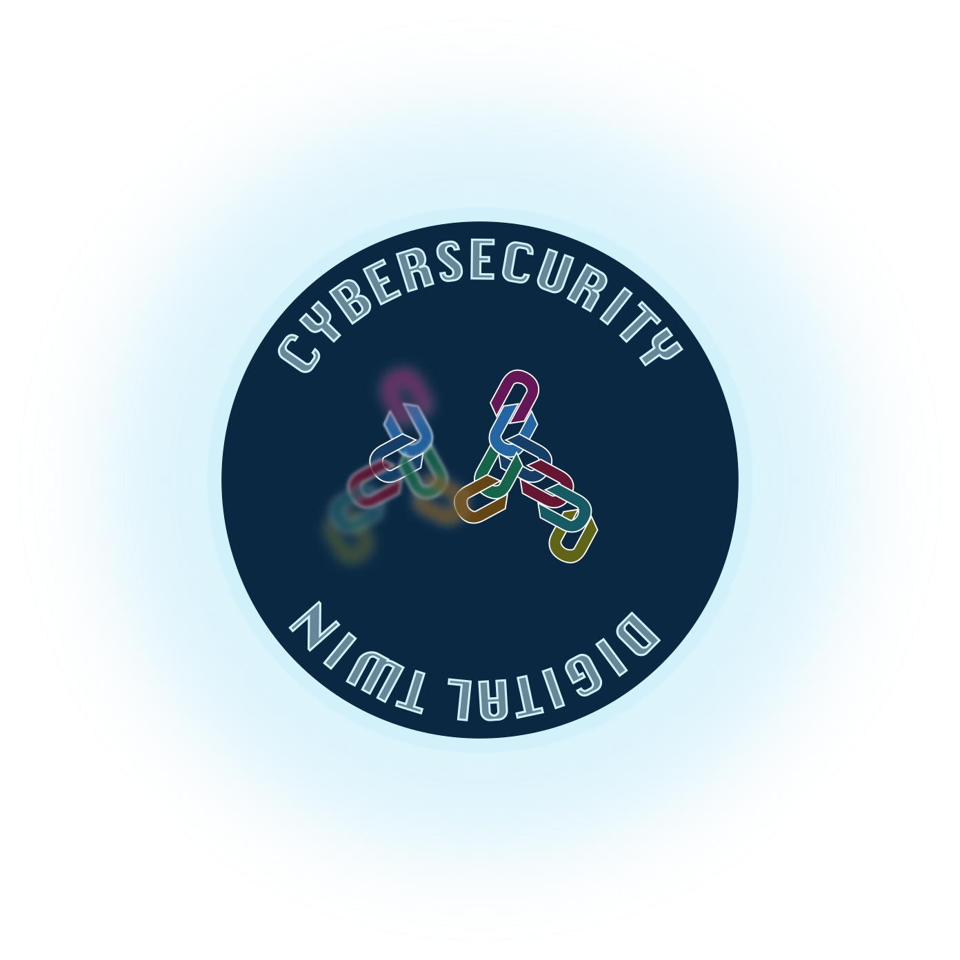
Discovering and modelling
Security API
REST-full
Open
Extensible
Cross-platform
Multi-ownership

Slide 11
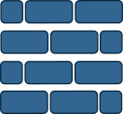
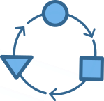
Improving cyber-security operations
Monitoring
Detection
Response
Hunting
Proactivity
Pervasivity
Adaptivity

Slide 12
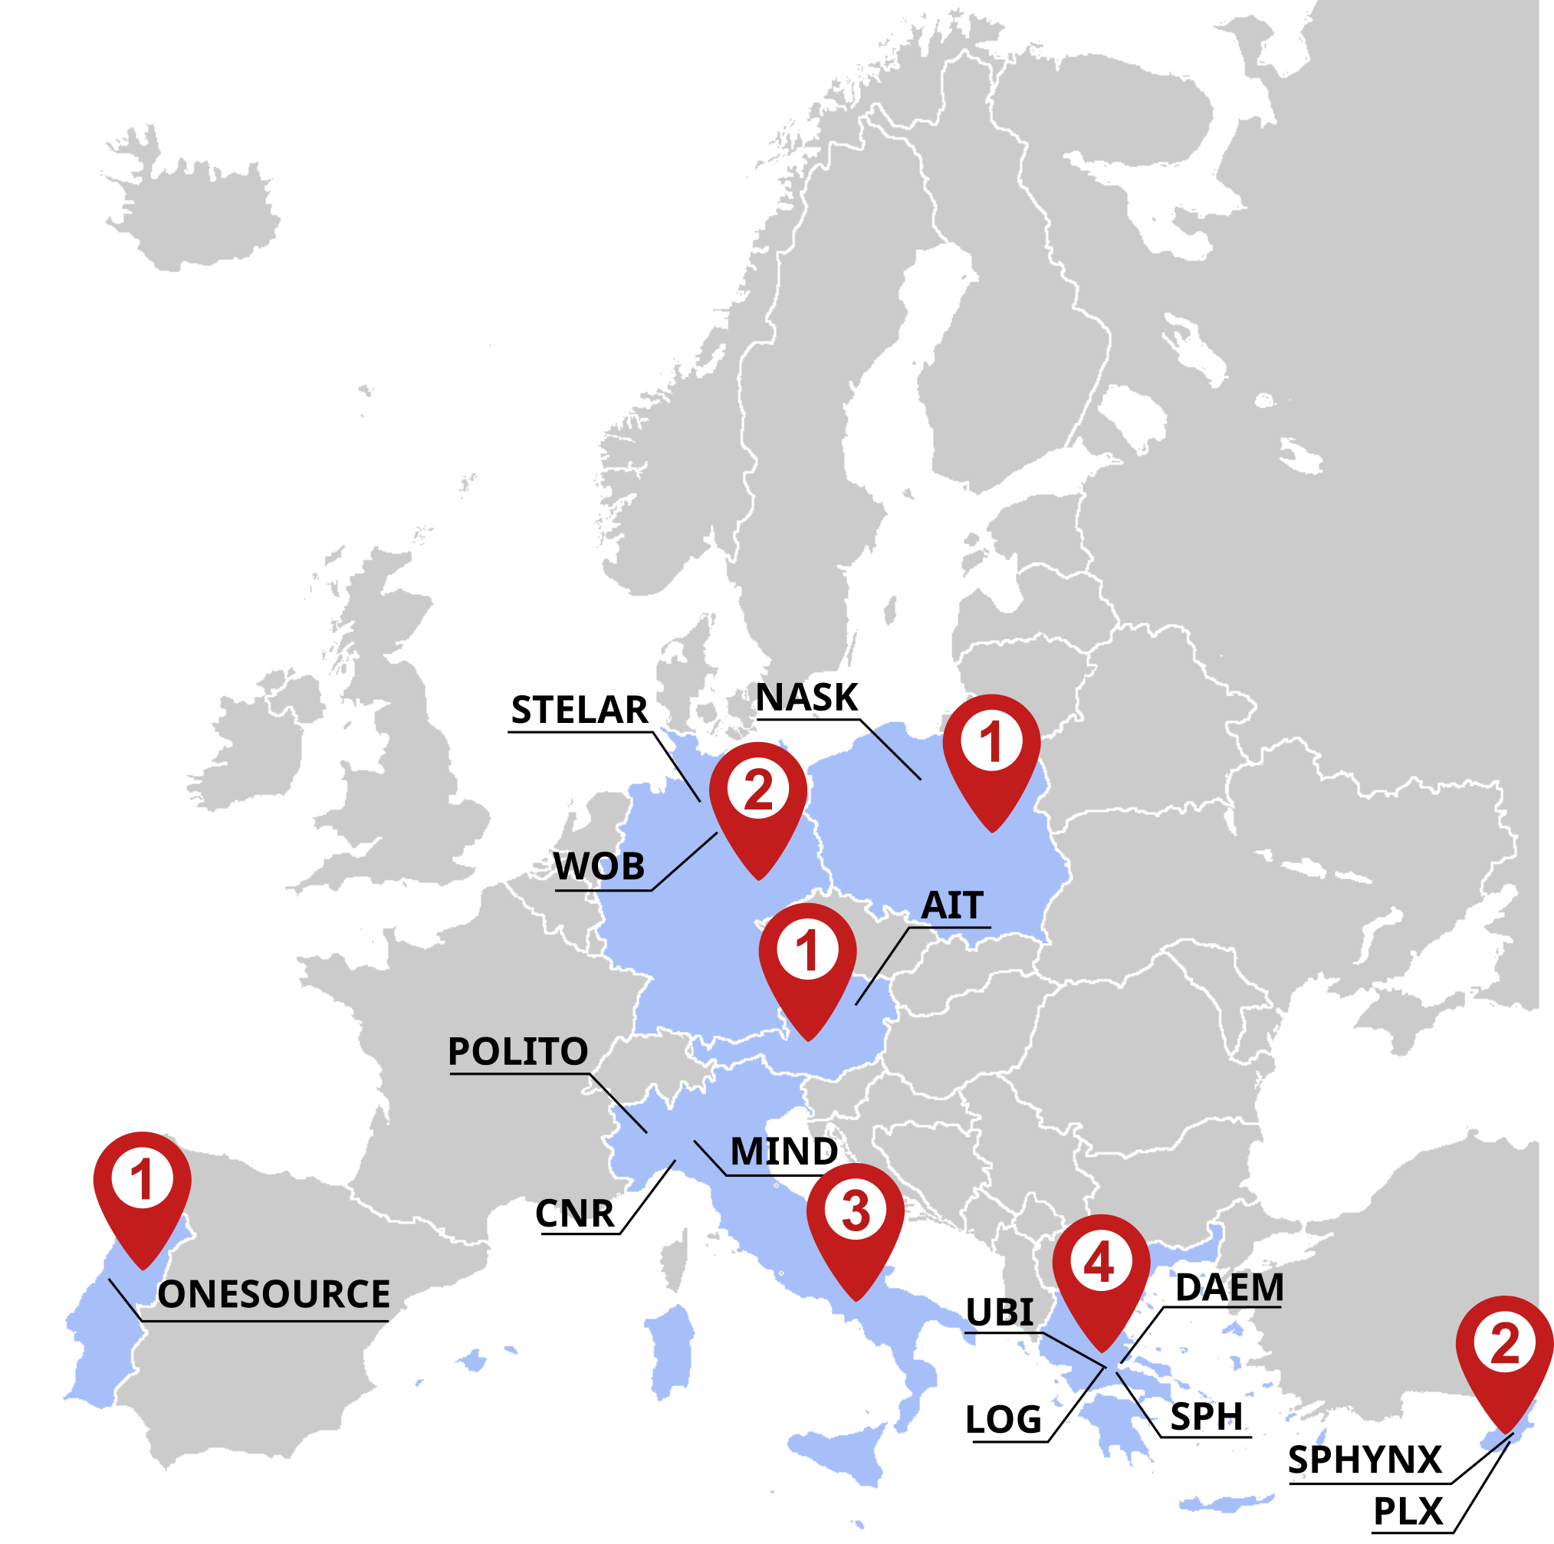
Project factsheet
Coordinator
Duration: 1/9/2024-31/8/2027
Budget: 7 308 925.00 €
Use Cases: Wolfsburg, Genoa, Athens
Partners
Notes:
The MIRANDA project started on 1st September 2024 and will run for 3 years. With a budget of more than 7 millions euros and 14 partners, the Consortium will validate and demonstrate its technologies in 3 Use Cases in Wolfsburg, Genoa, and Athens. Both are smart cities applications made of multiple services and infrastructures. MIRANDA explicitly addresses the needs for security in multi-domain and multi-ownership systems, like those you can build with FIWARE technologies. This is why I’m here today to introduce you the MIRANDA project, and I hope we can feed a continuous dialogue during and even after this project.

Slide 13
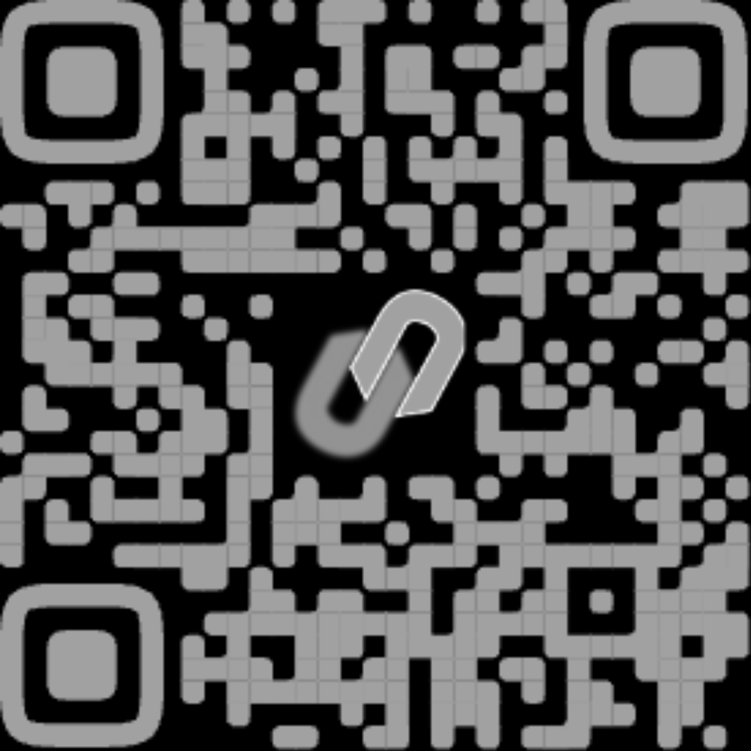
Project Coordinator
Matteo Repetto
Institute for Applied Mathematics and Information Technologies (IMATI), CNR
Genoa, Italy
info@mirandaproject.eu

Slide 14
Notes:
questions

