Slide 1
Smart City and Security
Thoughts on the risks behind digital interconnectedness
Matteo Repetto
CNR-IMATI

Slide 2
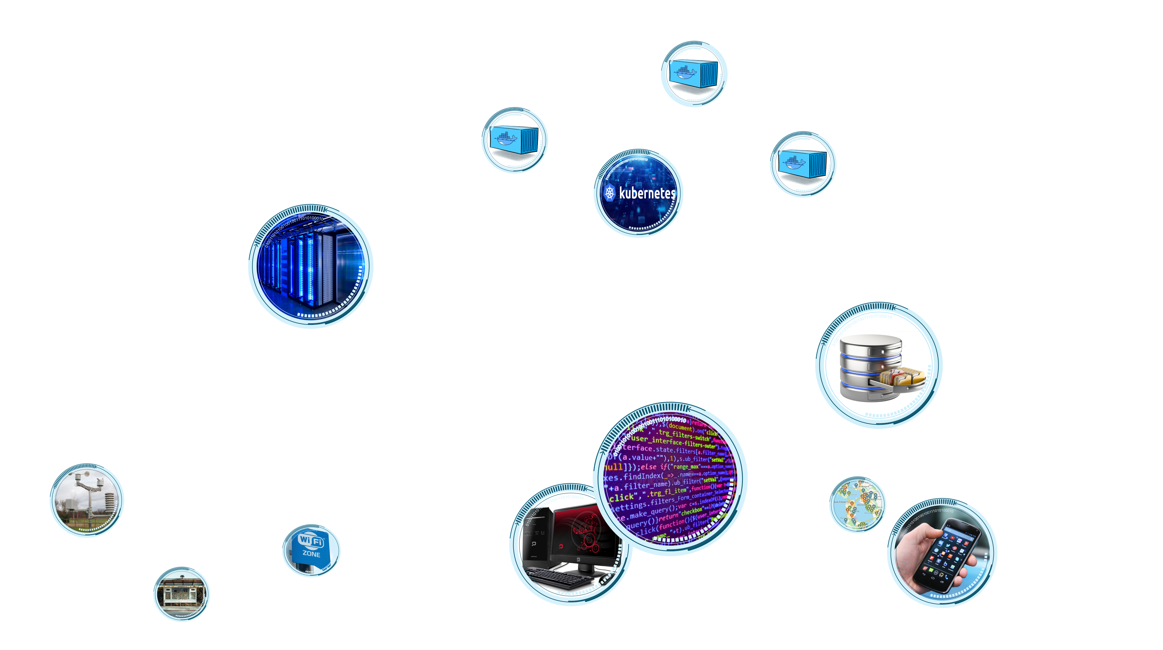

Digitalisation is all around

Slide 3
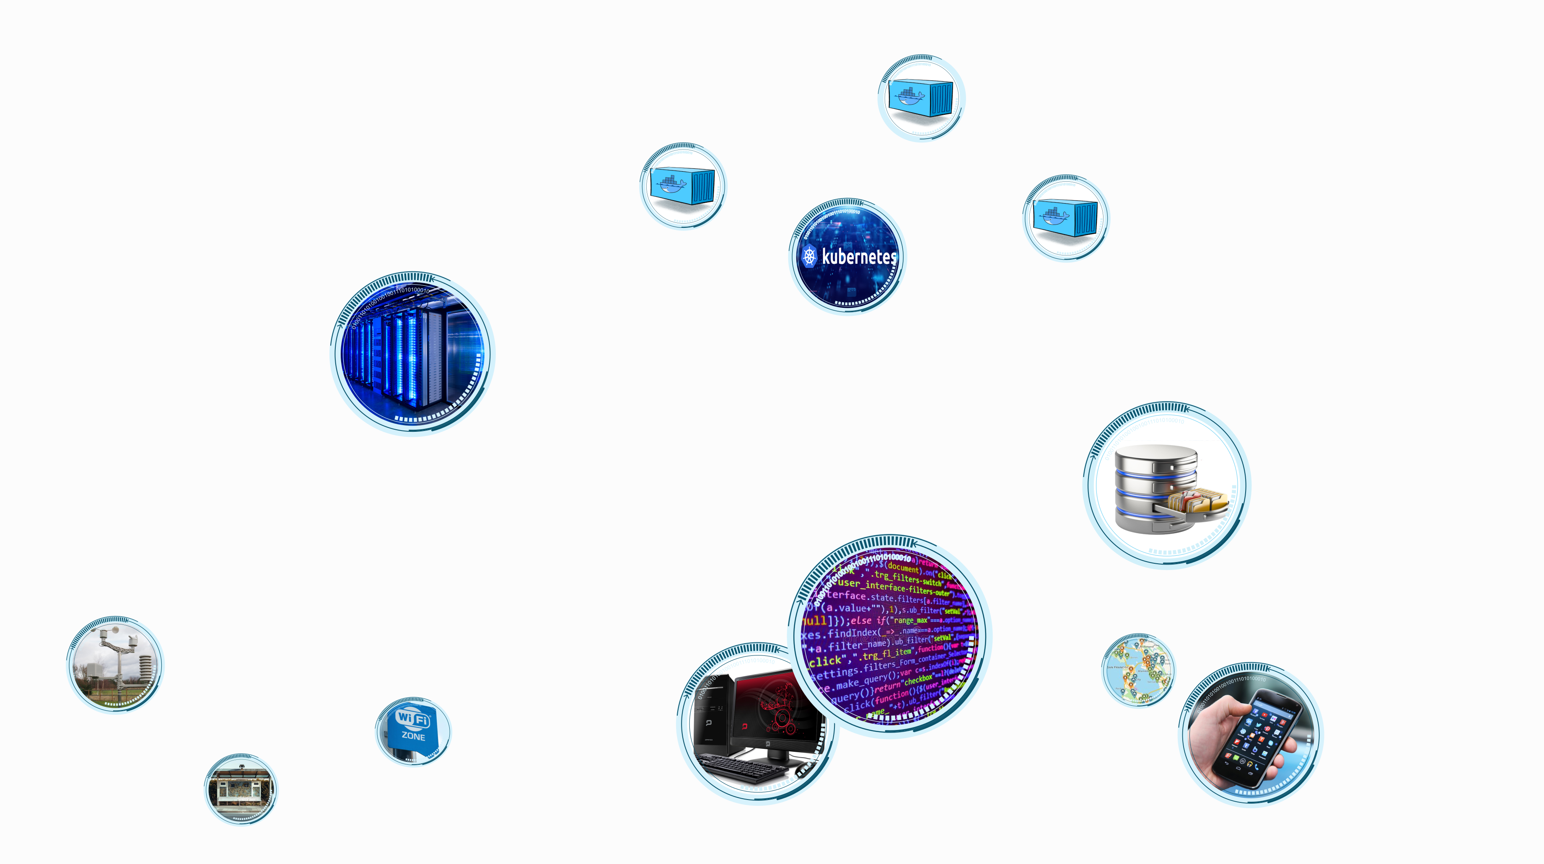

Smart City is digital connectivity

Slide 4

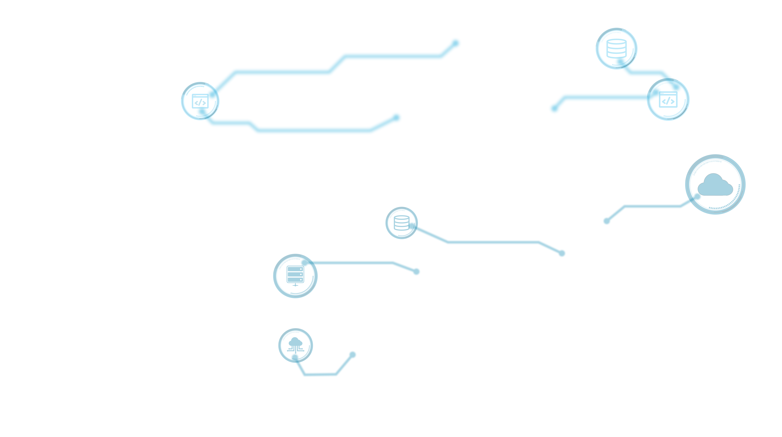

But… what’s behind a service?

Slide 5
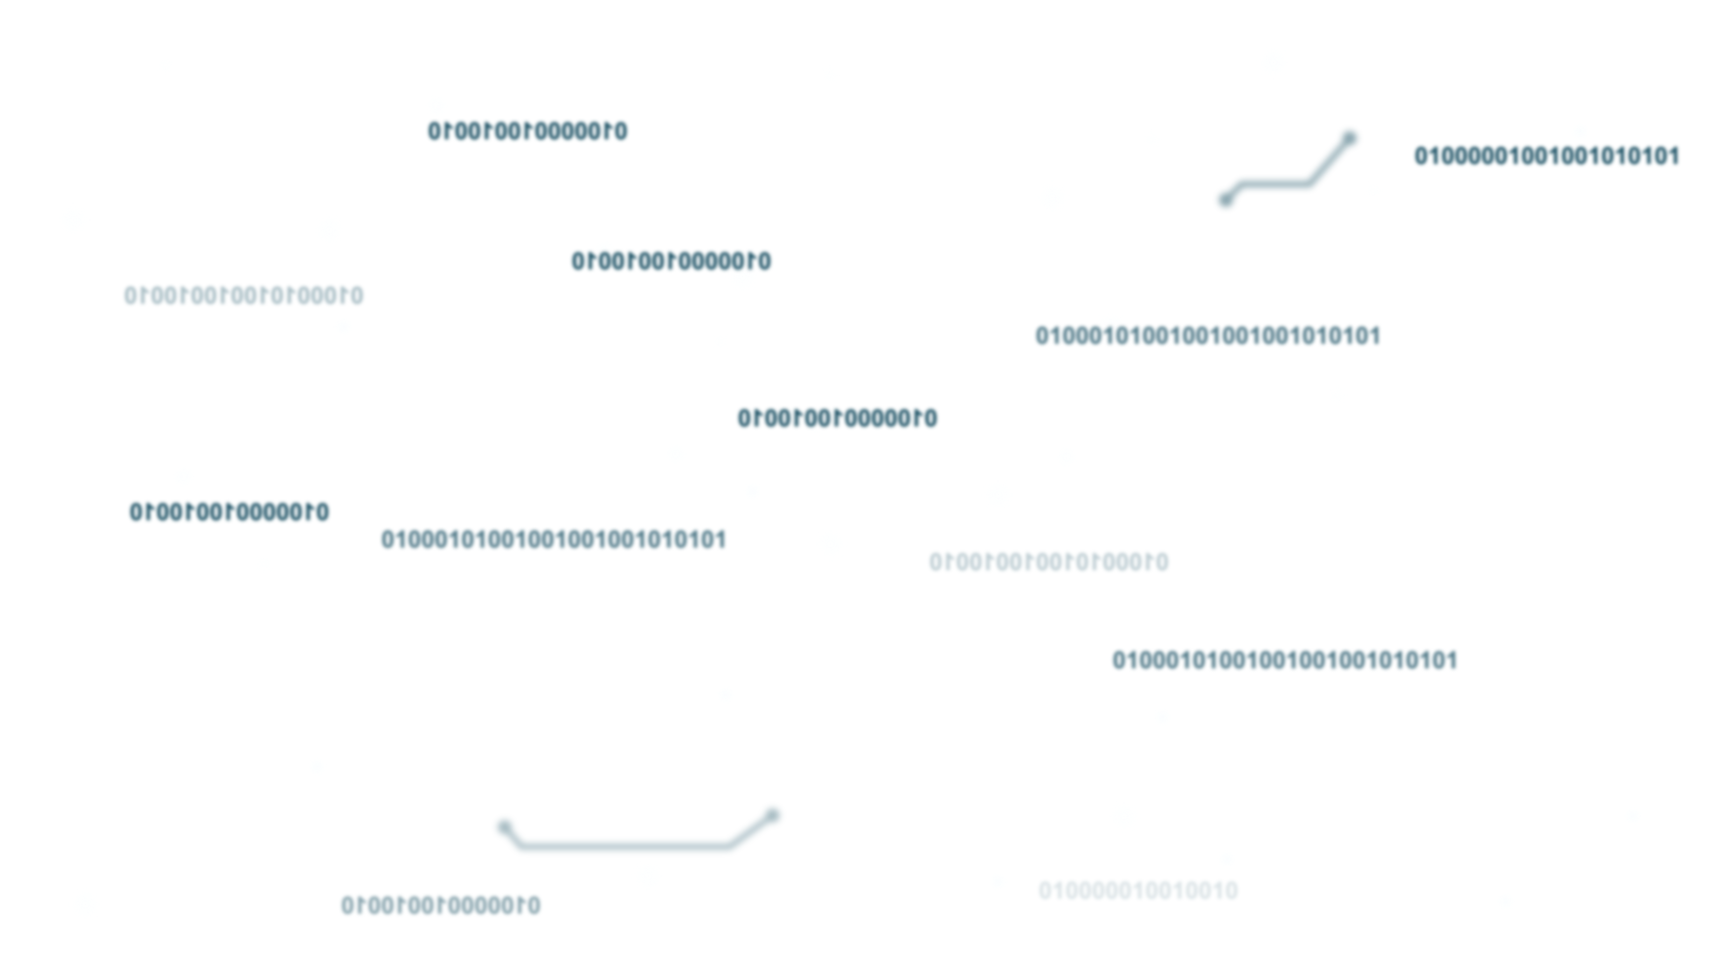
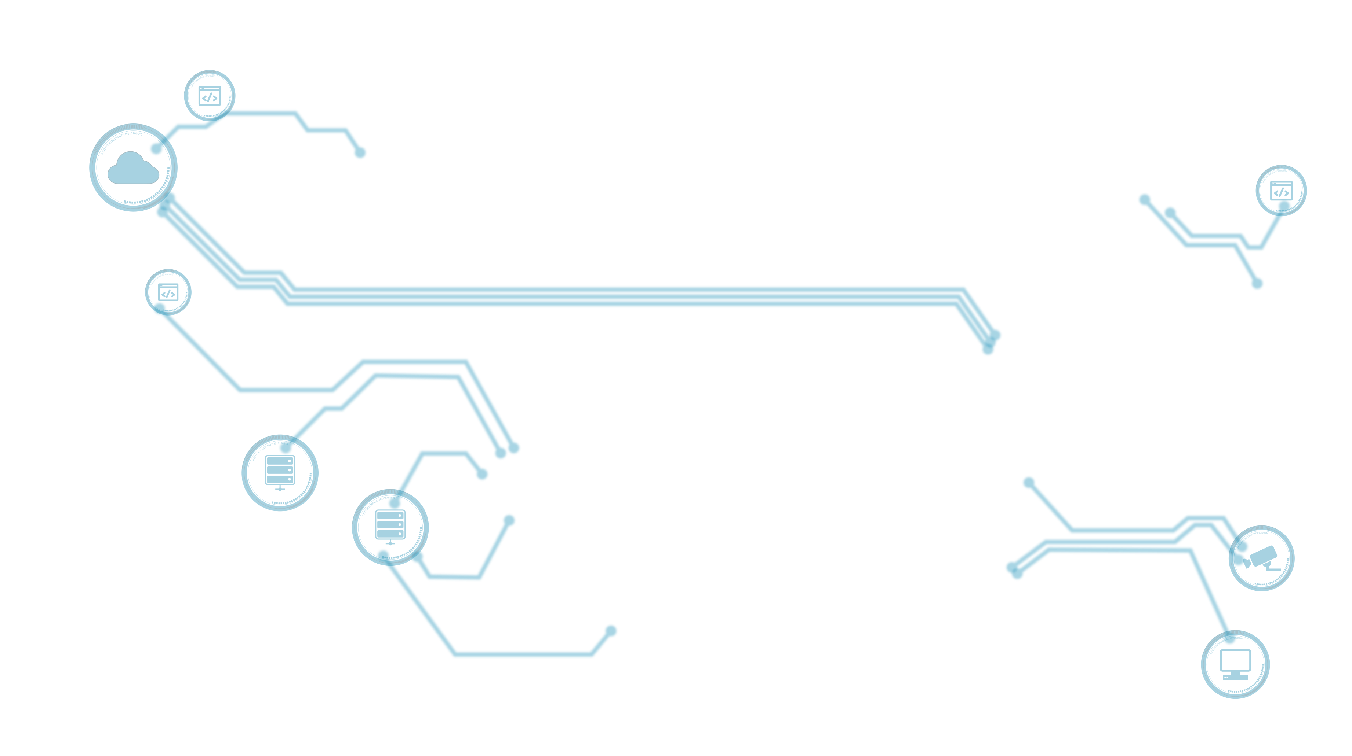
… and behind?

Slide 6
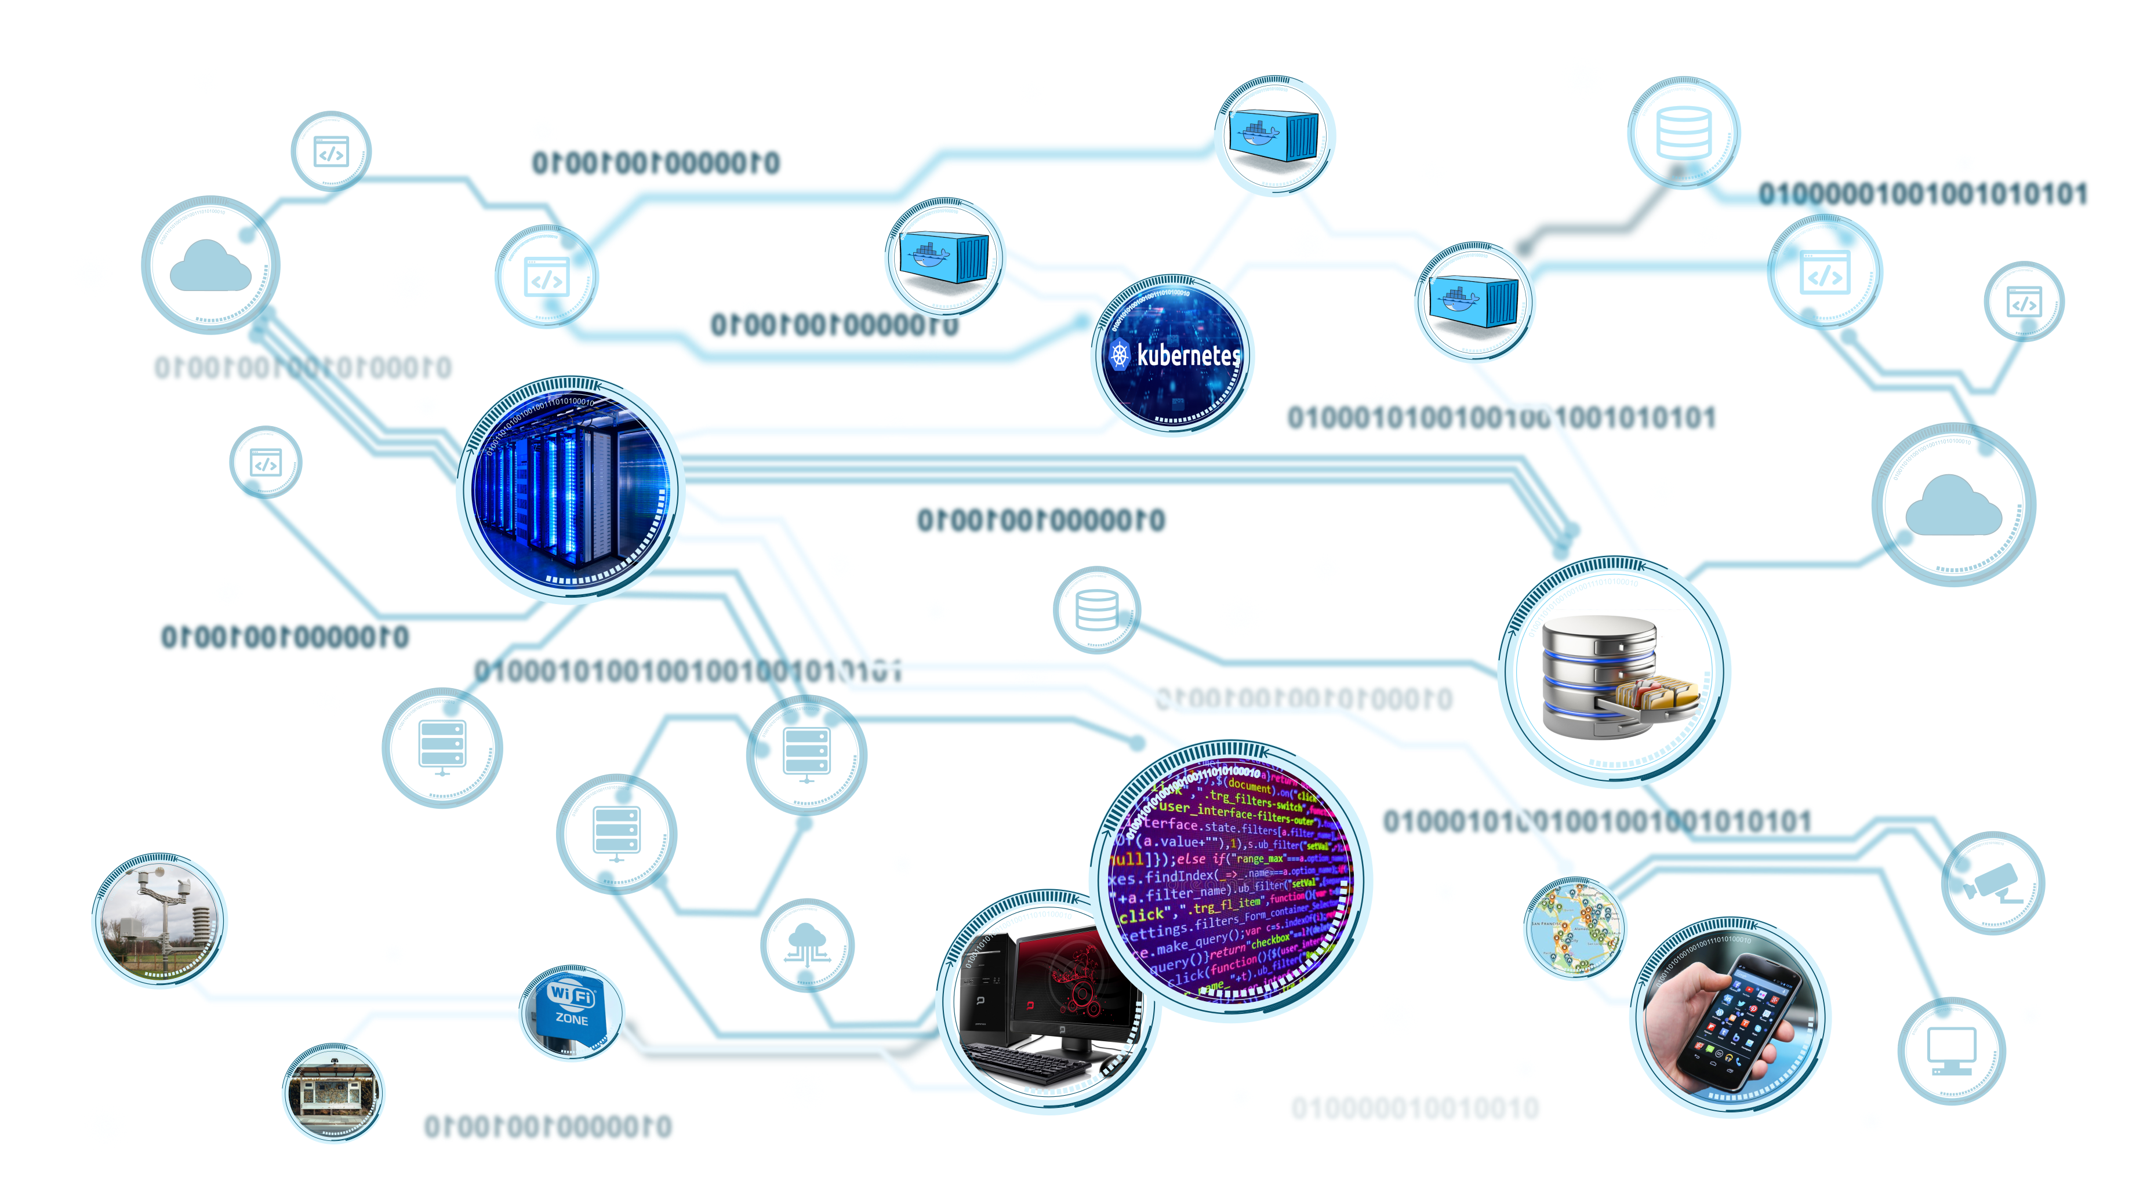
Every chain has its weakest link(s)!

Slide 7
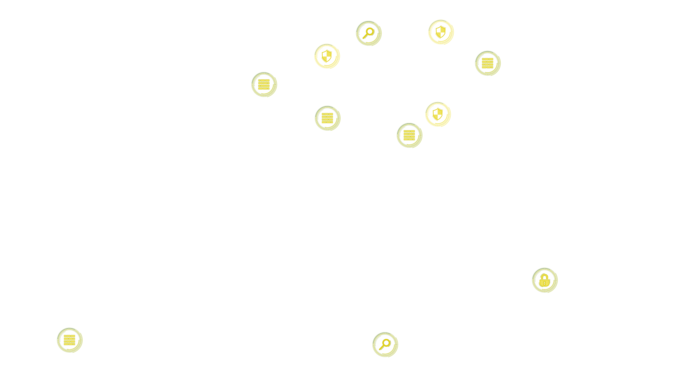


Wait… we have security functions in place!

Slide 8
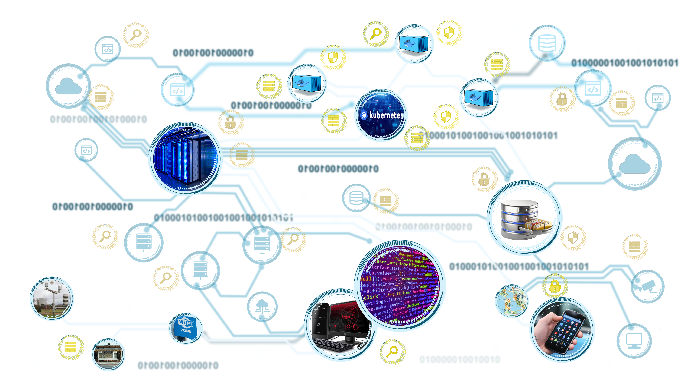
Do you really trust your suppliers?

Slide 9
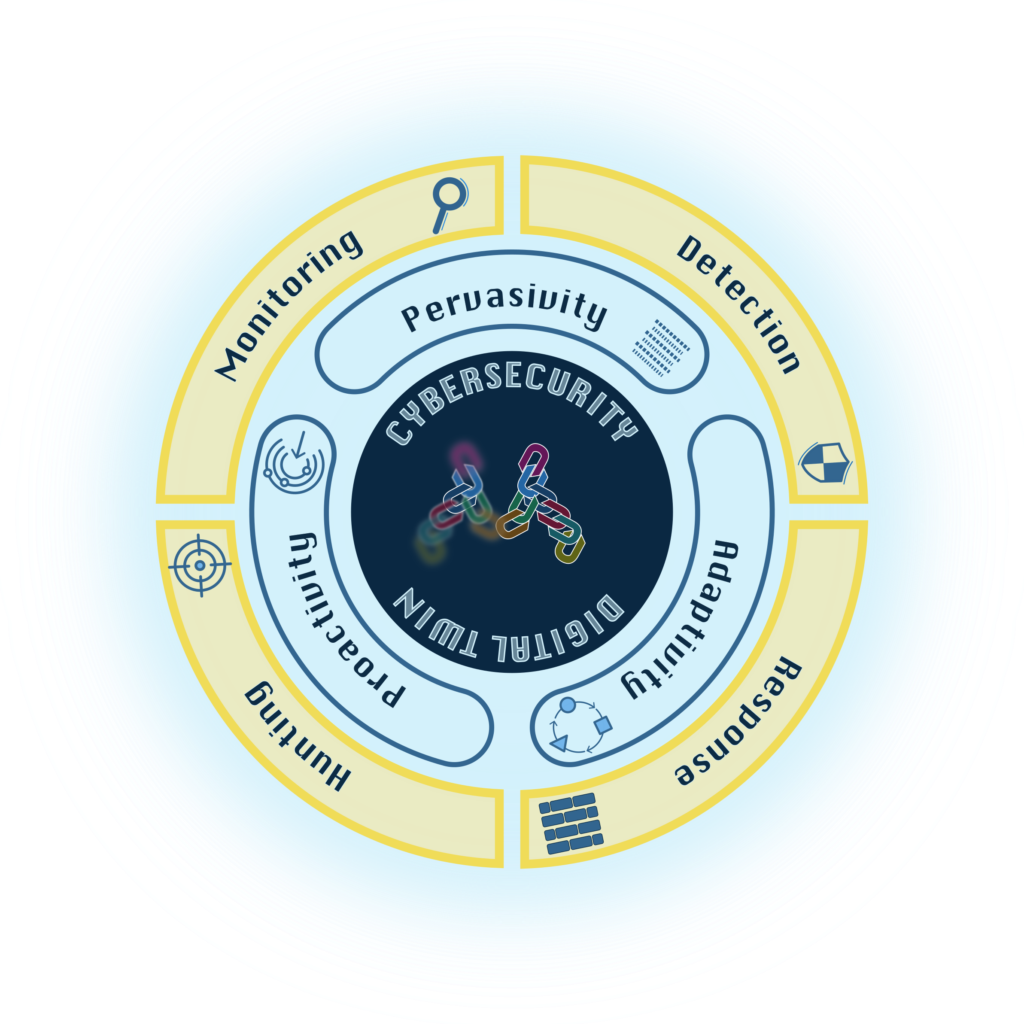
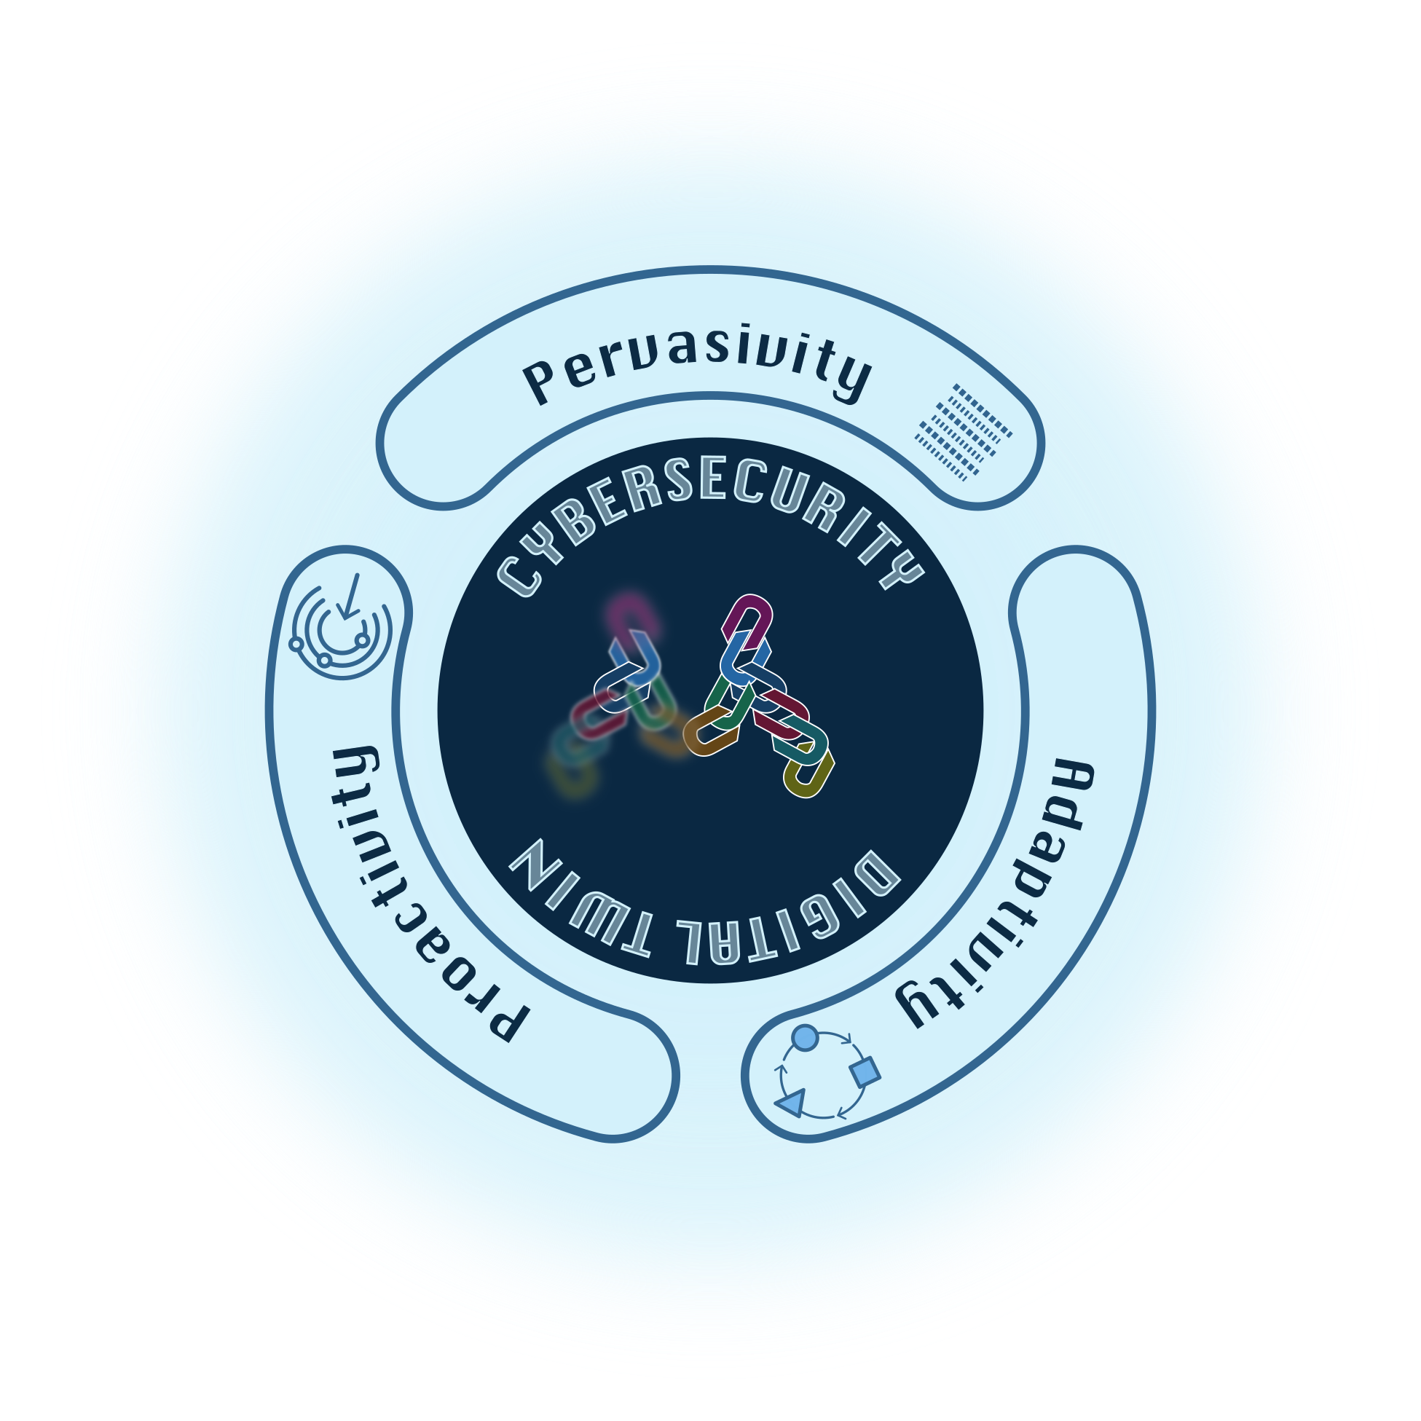
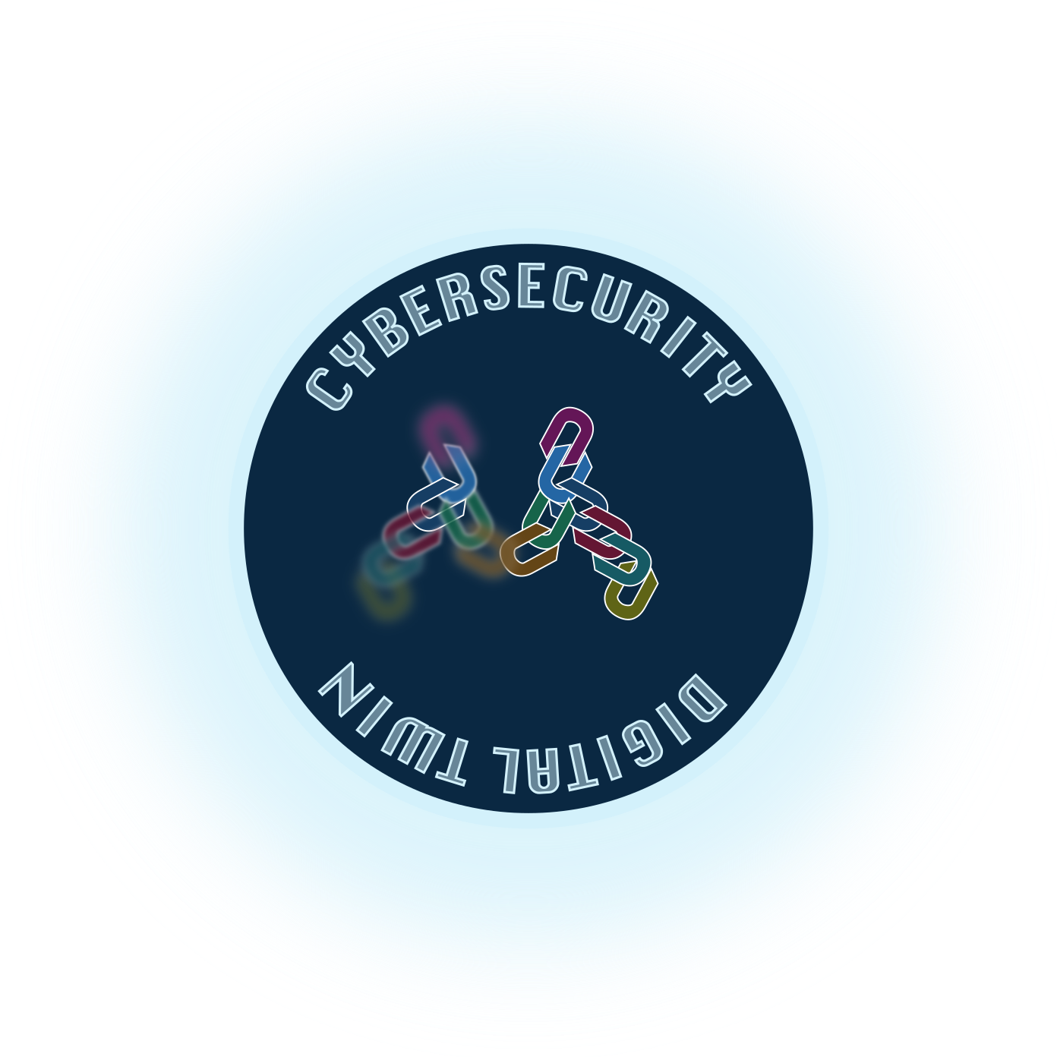
The MIRANDA project

Slide 10
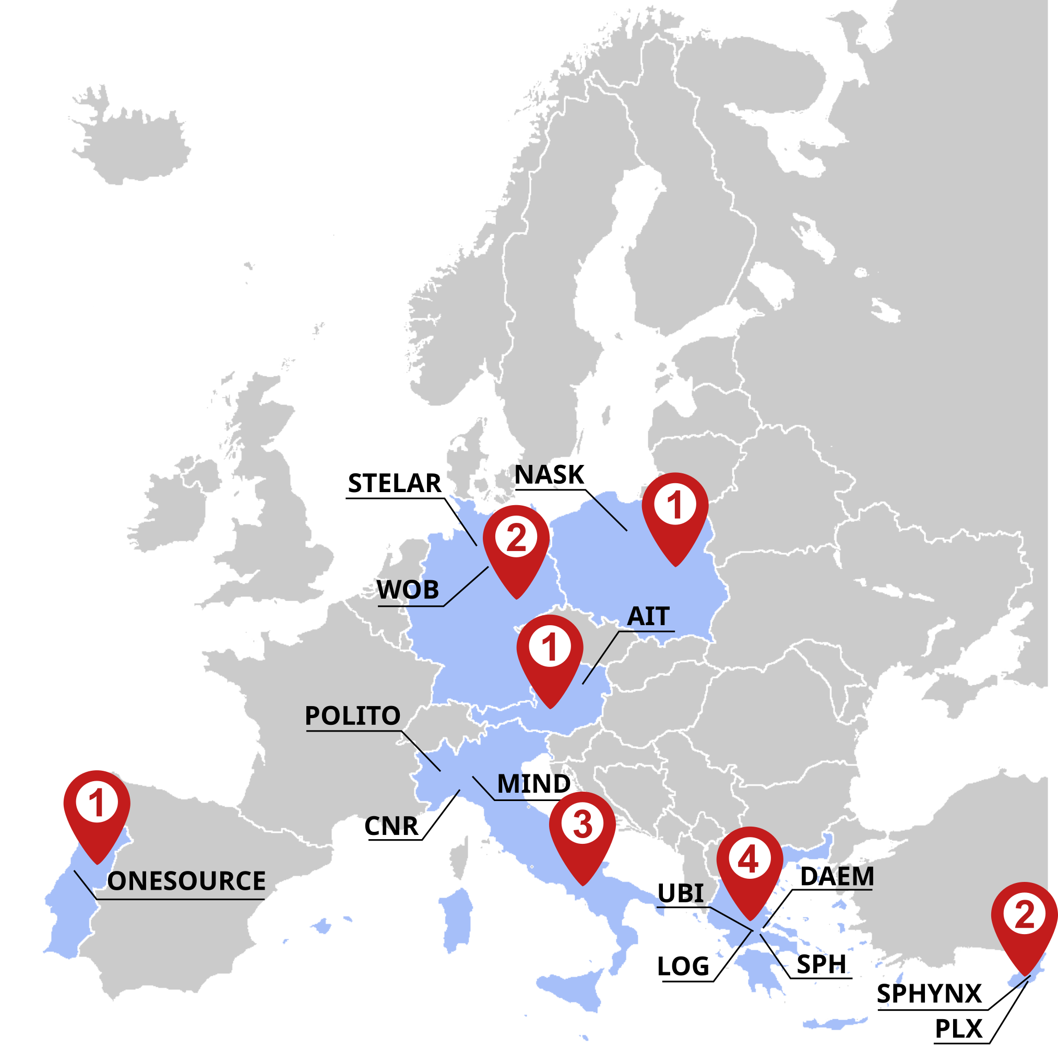




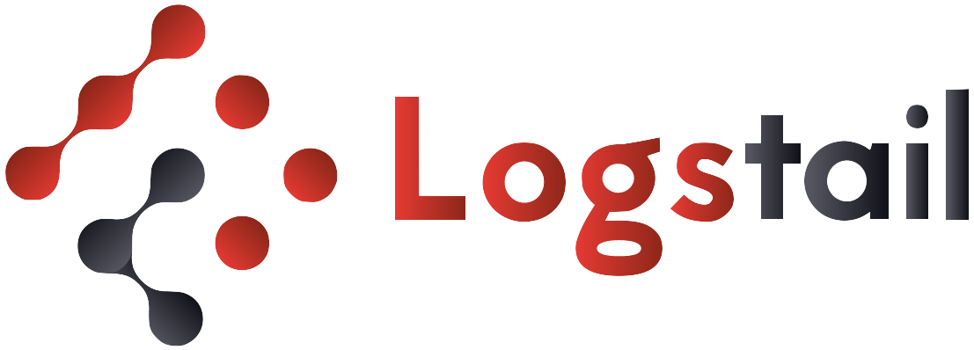









Project factsheet
Started: 1st September 2024
Duration: 36 months
Budget: 7 308 925.00 €
14 partners
3 Use Cases
  Wolfsburg, Genoa, Athens
Notes:
The MIRANDA project started on 1st September 2024 and will run for 3 years. With a budget of more than 7 millions euros and 14 partners, the Consortium will validate and demonstrate its technologies in 3 Use Cases in Wolfsburg, Genoa, and Athens. Both are smart cities applications made of multiple services and infrastructures. MIRANDA explicitly addresses the needs for security in multi-domain and multi-ownership systems, like those you can build with FIWARE technologies. This is why I’m here today to introduce you the MIRANDA project, and I hope we can feed a continuous dialogue during and even after this project.

Slide 11






Contacts
Project coordinator
  Matteo Repetto
  Institute for Applied Mathematics and Information Technologies (IMATI), CNR
  Genoa, Italy
  matteo.repetto@cnr.it
info@mirandaproject.eu
www.mirandaproject.eu
https://www.linkedin.com/company/105119663
@mirandaprj
@MIRANDA-Project
Notes:
For more information about MIRANDA, we can contact me, the Project Coordinator, and follow us on our social media. They are just starting and still incomplete right now, but they will be soon populated with all useful content and news in the following weeks.
I just conclude with the take-away message of my talk: be aware of cyber-security implications behind interconnectedness. Security is a global and collaborative matter today, and you cannot fight alone right the same way you cannot develop the whole components of your application from scratch. Be prepared to integrate cybersecurity APIs in your digital services and products. We’re pursuing standardization as an enabler of our ecosystem.

