Slide 1

6G Computing Continuum
New Security and Trustworthy Challenges
12th FOKUS FUSECO Forum
Luis Cordeiro
cordeiro@onesource.pt
OneSource, Portugal

Slide 2

6G Computing Continuum (6GCC)
Sixth-Generation Wireless Technology
Data Speeds and Latency
Integration of AI and Automation
Massive Connectivity
Advanced Spectrum Utilization
Holographic and Immersive Experiences
Sustainability Focus

Slide 3
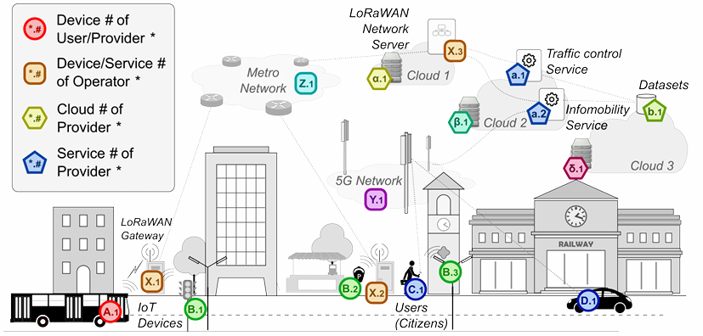
6G Computing Continuum (6GCC)
Distributed and decentralized processing
Edge-to-Edge Continuum
AI-Enhanced Operations
Unified Virtual Environment
Ultra-Reliable and Low-Latency Computing
Complex service interdependencies

Slide 4
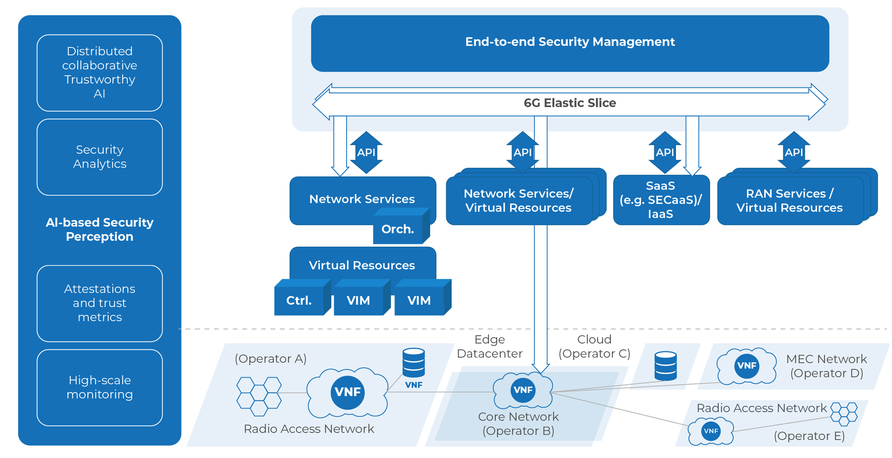
Challenges in 6G Security
Extreme cloudification
Increased exposure to cyber threats
Loss of direct control over data and infrastructure
Obscure shared responsibility model
Notes:
Extreme cloudification:
Increased Exposure to Cyber Threats
Loss of Direct Control Over Data and Infrastructure
Obscure shared responsibility model
Multi-vendor, multidomain at high scale:
Complexity in Security Management
Increased Attack Surface
Supply Chain and Dependency Risks
Dependency on Third-Party Security Practices
Monitoring and Incident Response Complexity
Adaptative, fast and not attended cybersecurity management:
Cybersecurity must adapt to an heterogenous, multi-provider environment
Security must adapt to fast changing environments
AI-based models must rely on minimal operator input
ZSM Security E2E orchestration over heterogeneous resources:
Automation Amplifies Vulnerabilities
while efficient, can also propagate vulnerabilities if not properly managed
automated workflows could spread the issue across the network or infrastructure, multiplying the risk of a breach
While this enhances efficiency, it reduces human oversight that might otherwise catch unusual activity or errors

Slide 5
Challenges in 6G Security
Multi-vendor, multi-domain at high scale
Complexity in security management
Increased attack surface
Supply chain and dependency risks
Dependency on third-party security practices
Monitoring and incident response complexity
Notes:
Extreme cloudification:
Increased Exposure to Cyber Threats
Loss of Direct Control Over Data and Infrastructure
Obscure shared responsibility model
Multi-vendor, multidomain at high scale:
Complexity in Security Management
Increased Attack Surface
Supply Chain and Dependency Risks
Dependency on Third-Party Security Practices
Monitoring and Incident Response Complexity
Adaptative, fast and not attended cybersecurity management:
Cybersecurity must adapt to an heterogenous, multi-provider environment
Security must adapt to fast changing environments
AI-based models must rely on minimal operator input
ZSM Security E2E orchestration over heterogeneous resources:
Automation Amplifies Vulnerabilities
while efficient, can also propagate vulnerabilities if not properly managed
automated workflows could spread the issue across the network or infrastructure, multiplying the risk of a breach
While this enhances efficiency, it reduces human oversight that might otherwise catch unusual activity or errors

Slide 6
Challenges in 6G Security
Adaptative, fast and not attended cybersecurity management
Cybersecurity must adapt to an heterogenous, multi-provider environment
Security must adapt to fast changing environments
AI-based models must rely on minimal operator input
Notes:
Extreme cloudification:
Increased Exposure to Cyber Threats
Loss of Direct Control Over Data and Infrastructure
Obscure shared responsibility model
Multi-vendor, multidomain at high scale:
Complexity in Security Management
Increased Attack Surface
Supply Chain and Dependency Risks
Dependency on Third-Party Security Practices
Monitoring and Incident Response Complexity
Adaptative, fast and not attended cybersecurity management:
Cybersecurity must adapt to an heterogenous, multi-provider environment
Security must adapt to fast changing environments
AI-based models must rely on minimal operator input
ZSM Security E2E orchestration over heterogeneous resources:
Automation Amplifies Vulnerabilities
while efficient, can also propagate vulnerabilities if not properly managed
automated workflows could spread the issue across the network or infrastructure, multiplying the risk of a breach
While this enhances efficiency, it reduces human oversight that might otherwise catch unusual activity or errors

Slide 7
Challenges in 6G Security
ZSM Security E2E orchestration over heterogeneous resources
Enhances efficiency
Automation amplifies vulnerabilities
Can propagate vulnerabilities if not properly managed
Can multiply the risk of a breach
Reduces human oversight that might catch unusual activity or errors
Notes:
Extreme cloudification:
Increased Exposure to Cyber Threats
Loss of Direct Control Over Data and Infrastructure
Obscure shared responsibility model
Multi-vendor, multidomain at high scale:
Complexity in Security Management
Increased Attack Surface
Supply Chain and Dependency Risks
Dependency on Third-Party Security Practices
Monitoring and Incident Response Complexity
Adaptative, fast and not attended cybersecurity management:
Cybersecurity must adapt to an heterogenous, multi-provider environment
Security must adapt to fast changing environments
AI-based models must rely on minimal operator input
ZSM Security E2E orchestration over heterogeneous resources:
Automation Amplifies Vulnerabilities
while efficient, can also propagate vulnerabilities if not properly managed
automated workflows could spread the issue across the network or infrastructure, multiplying the risk of a breach
While this enhances efficiency, it reduces human oversight that might otherwise catch unusual activity or errors

Slide 8
Challenges in 6G Security
Secure and privacy lifecycle management
Services and application
Focus on security in the DevOps cycle
DevSecOps strategies
Addressing the security needs in the software development process from the beginning
Increased effectiveness of regulatory compliance without affecting software quality
Notes:
Secure and privacy lifecycle management of the services and application:
Keeping a key focus on security in the DevOps cycle, enforcing DevSecOps strategies
Addressing the security needs in the software development process from the beginning
Reduces the risk of security vulnerabilities and breaches
Increased effectiveness of regulatory compliance without affecting software quality
Collaborative and AI-driven self healing of networks
Reconfiguration and self healing of the network
Reliable Cyber-awareness orchestration
Dynamic end points (mobility, NTN)
ZTA (Zero Trust Architectures)
meaning that no user or system should be trusted by default
Difficult to handle the large scale and computing systems
Current ZTA mostly rely on fine-grained access control strategies
Trustworthy & privacy-preserving data management
ensure data is handled securely and responsibly throughout its lifecycle while respecting users' privacy rights
Application of ML may increase the risk of data leakage
Privacy-preserving techniques must be included
Intelligent, predictive, AI adoption for security threat analysis and reaction
AI algorithms to effectively analyze large-scale network traffic and system logs, and user behaviour
Scalability allows AI to detect subtle indicators of threat difficult for human operator

Slide 9
Challenges in 6G Security
Collaborative and AI-driven self healing of networks
Reconfiguration and self healing of the network
Reliable cyber-awareness orchestration
Dynamic end points (mobility, NTN)
Notes:
Secure and privacy lifecycle management of the services and application:
Keeping a key focus on security in the DevOps cycle, enforcing DevSecOps strategies
Addressing the security needs in the software development process from the beginning
Reduces the risk of security vulnerabilities and breaches
Increased effectiveness of regulatory compliance without affecting software quality
Collaborative and AI-driven self healing of networks
Reconfiguration and self healing of the network
Reliable Cyber-awareness orchestration
Dynamic end points (mobility, NTN)
ZTA (Zero Trust Architectures)
meaning that no user or system should be trusted by default
Difficult to handle the large scale and computing systems
Current ZTA mostly rely on fine-grained access control strategies
Trustworthy & privacy-preserving data management
ensure data is handled securely and responsibly throughout its lifecycle while respecting users' privacy rights
Application of ML may increase the risk of data leakage
Privacy-preserving techniques must be included
Intelligent, predictive, AI adoption for security threat analysis and reaction
AI algorithms to effectively analyze large-scale network traffic and system logs, and user behaviour
Scalability allows AI to detect subtle indicators of threat difficult for human operator

Slide 10
Challenges in 6G Security
Zero Trust Architectures (ZTA)
No user or system should be trusted by default
Difficult to handle the large-scale computing systems
Current ZTA mostly rely on fine-grained access control strategies
Notes:
Secure and privacy lifecycle management of the services and application:
Keeping a key focus on security in the DevOps cycle, enforcing DevSecOps strategies
Addressing the security needs in the software development process from the beginning
Reduces the risk of security vulnerabilities and breaches
Increased effectiveness of regulatory compliance without affecting software quality
Collaborative and AI-driven self healing of networks
Reconfiguration and self healing of the network
Reliable Cyber-awareness orchestration
Dynamic end points (mobility, NTN)
ZTA (Zero Trust Architectures)
meaning that no user or system should be trusted by default
Difficult to handle the large scale and computing systems
Current ZTA mostly rely on fine-grained access control strategies
Trustworthy & privacy-preserving data management
ensure data is handled securely and responsibly throughout its lifecycle while respecting users' privacy rights
Application of ML may increase the risk of data leakage
Privacy-preserving techniques must be included
Intelligent, predictive, AI adoption for security threat analysis and reaction
AI algorithms to effectively analyze large-scale network traffic and system logs, and user behaviour
Scalability allows AI to detect subtle indicators of threat difficult for human operator

Slide 11
Challenges in 6G Security
Trustworthy & privacy-preserving data management
Ensure data is handled securely and responsibly throughout its lifecycle while respecting users' privacy rights
Application of ML may increase the risk of data leakage
Privacy-preserving techniques are key
Notes:
Secure and privacy lifecycle management of the services and application:
Keeping a key focus on security in the DevOps cycle, enforcing DevSecOps strategies
Addressing the security needs in the software development process from the beginning
Reduces the risk of security vulnerabilities and breaches
Increased effectiveness of regulatory compliance without affecting software quality
Collaborative and AI-driven self healing of networks
Reconfiguration and self healing of the network
Reliable Cyber-awareness orchestration
Dynamic end points (mobility, NTN)
ZTA (Zero Trust Architectures)
meaning that no user or system should be trusted by default
Difficult to handle the large scale and computing systems
Current ZTA mostly rely on fine-grained access control strategies
Trustworthy & privacy-preserving data management
ensure data is handled securely and responsibly throughout its lifecycle while respecting users' privacy rights
Application of ML may increase the risk of data leakage
Privacy-preserving techniques must be included
Intelligent, predictive, AI adoption for security threat analysis and reaction
AI algorithms to effectively analyze large-scale network traffic and system logs, and user behaviour
Scalability allows AI to detect subtle indicators of threat difficult for human operator

Slide 12
Challenges in 6G Security
Intelligent, predictive, AI adoption for security threat analysis and reaction
AI algorithms to effectively analyze large-scale network traffic and system logs, and user behaviour
Scalability allows AI to detect subtle indicators of threat difficult for human operator
Notes:
Secure and privacy lifecycle management of the services and application:
Keeping a key focus on security in the DevOps cycle, enforcing DevSecOps strategies
Addressing the security needs in the software development process from the beginning
Reduces the risk of security vulnerabilities and breaches
Increased effectiveness of regulatory compliance without affecting software quality
Collaborative and AI-driven self healing of networks
Reconfiguration and self healing of the network
Reliable Cyber-awareness orchestration
Dynamic end points (mobility, NTN)
ZTA (Zero Trust Architectures)
meaning that no user or system should be trusted by default
Difficult to handle the large scale and computing systems
Current ZTA mostly rely on fine-grained access control strategies
Trustworthy & privacy-preserving data management
ensure data is handled securely and responsibly throughout its lifecycle while respecting users' privacy rights
Application of ML may increase the risk of data leakage
Privacy-preserving techniques must be included
Intelligent, predictive, AI adoption for security threat analysis and reaction
AI algorithms to effectively analyze large-scale network traffic and system logs, and user behaviour
Scalability allows AI to detect subtle indicators of threat difficult for human operator

Slide 13

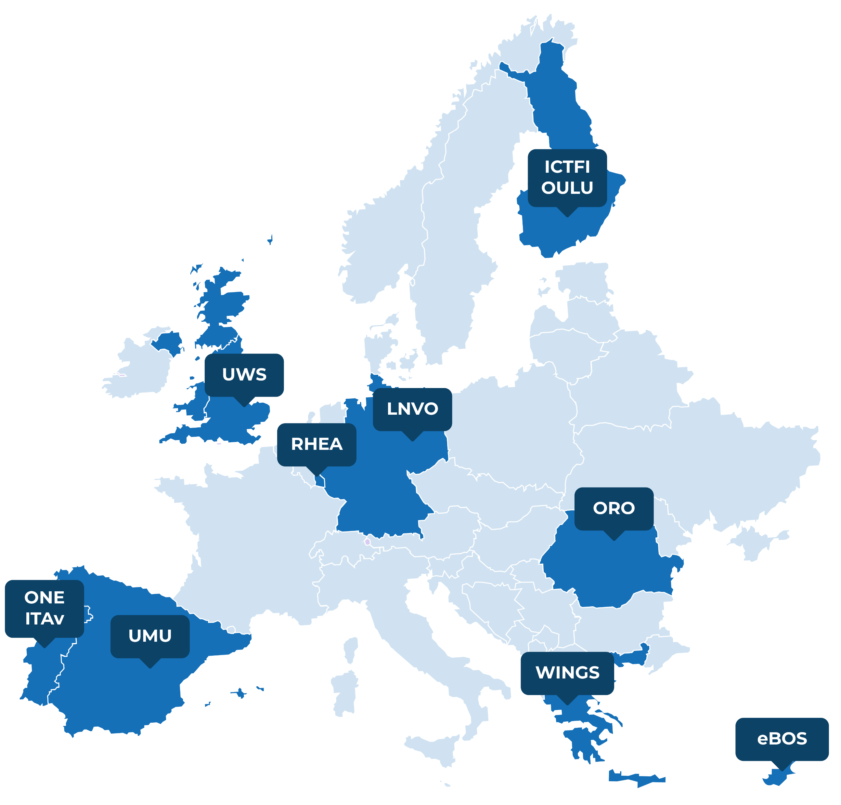

RIGOUROUS secuRe desIGn and deplOyment of trUsthwoRthy cOntinUum computing 6G Services
The project demonstrates its results through a set of industrially relevant use cases in operational environments:
Protection of 6G-enabled Services against Cyber Threats
Digital City Twining Platform
Utilities Management and security
PPDR IoT Situational Awareness platform
Consortium composed of 11 partners from 8 countries.
4 Use Cases, 7 testbeds
https://rigourous.eu/
RIGOUROUS has received funding from the European Union’s HE Research and Innovation Programme HORIZON-JU-SNS-2022 under Grant Agreement No 101095933

Slide 14

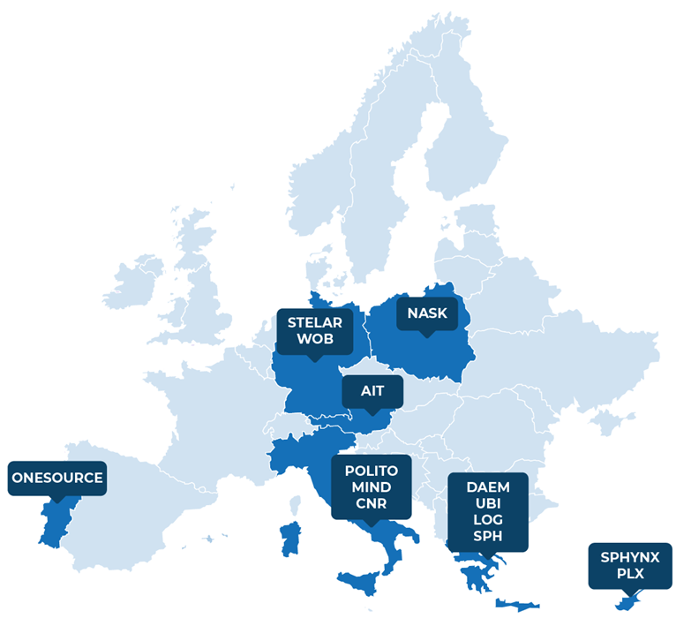
MIRANDA
Monitoring, Investigation and Response to cyber-attacks with an Adaptive digital twiN moDel for Agile services over the computing continuum
The project demonstrates its results using a set of relevant use cases to setup the MIRANDA framework:
Wolfsburg Digital
Inclusive Genoa
Safe Athens
Consortium composed of 14 partners from 7 countries
3 use cases
https://www.mirandaproject.eu/
MIRANDA has received funding from the European Union’s HE Research and Innovation Programme under Grant Agreement No. 101168144

Slide 15
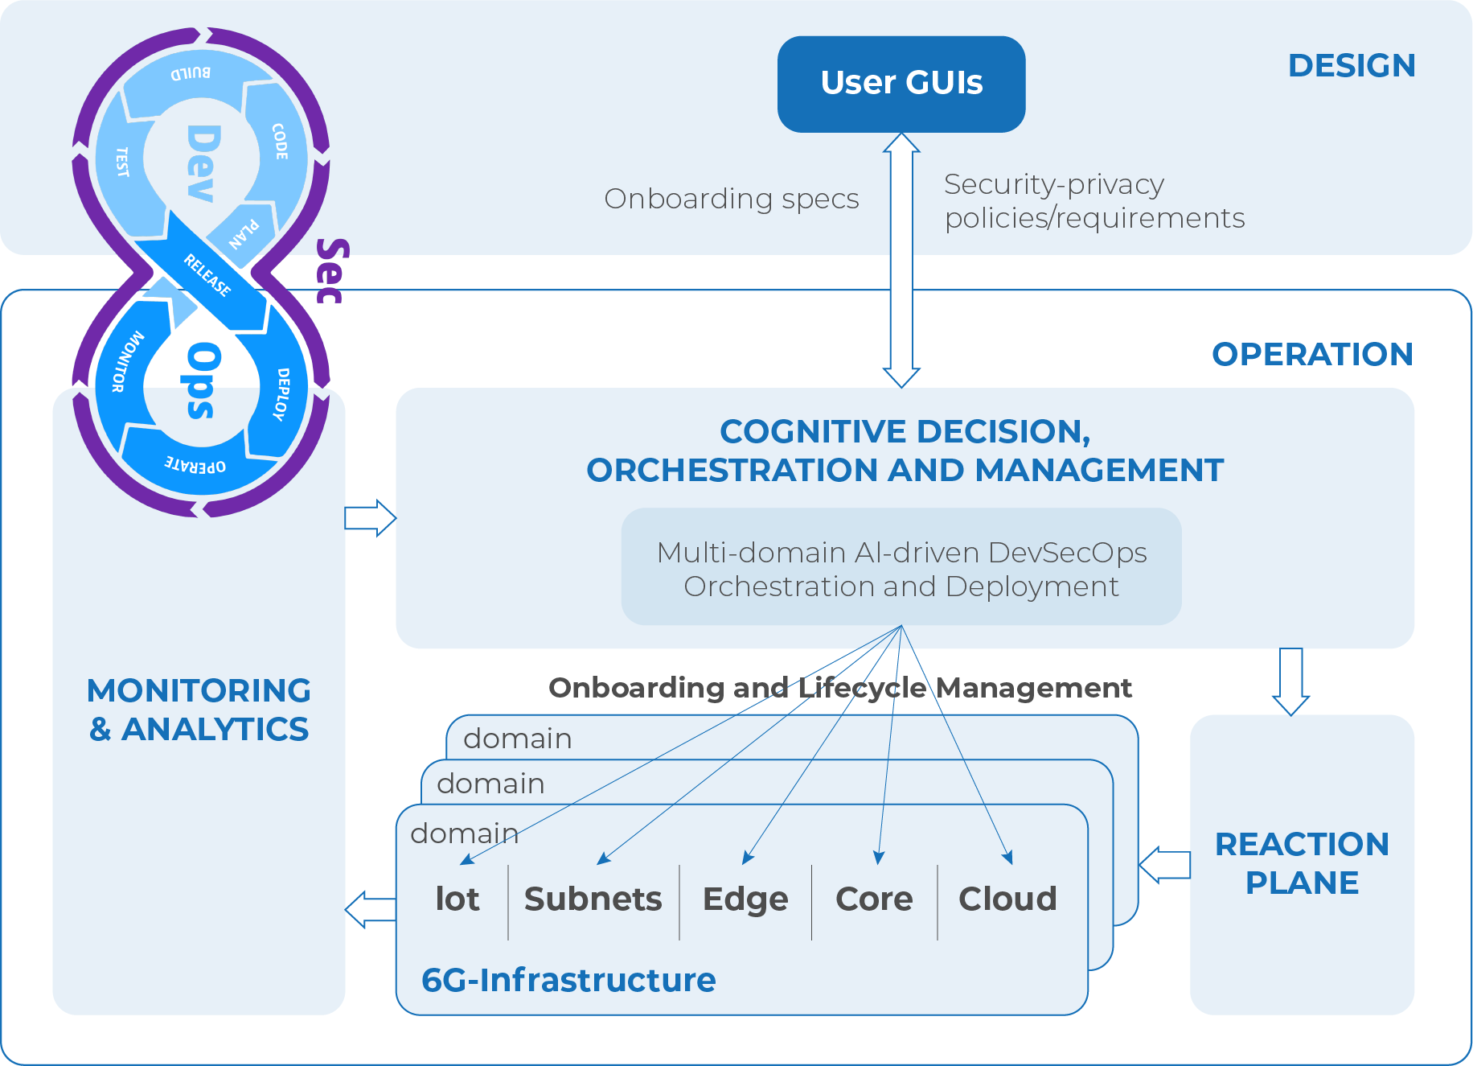
DevSecOps
Extending DevOps with security practices
Security by design
Automated CI/CD pipelines
Multi-point AI security based
Human-Centric DevSecOps

Slide 16
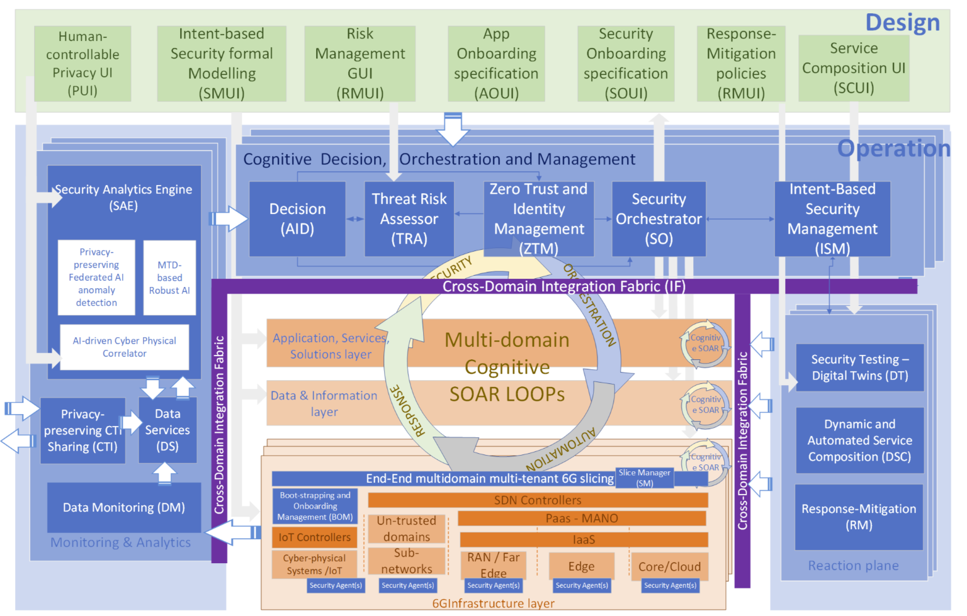
Security Orchestration
Model-based and AI-Driven automated
Multi-Domain AI-Driven orchestrator
FL based security orchestration decisions
Trust evaluation and enabler service framework
IoT bootstrapping and onboarding mechanisms
Trusted application onboarding
Security control Agents and Security Slice Controllers

Slide 17

Holistic Smart Service Framework
Securing the IoT-Edge-Cloud Continuum lifecycle management
Secure communication between IoT gateways and microservices
Federated AI-governed framework
AI-Driven Security Management
Zero-trust & Cognitive SOAR (Security Orchestration, Automation, and Response) loops
End-to-End Slicing
Dynamic Service Composition
Trust Evaluation & Maintenance
Notes:
Federated AI-Governed Framework: A zero-touch cognitive and secure management framework to oversee DevSecOps across diverse 6G cross-domain and cross-network segments.
AI-Driven Security Management: Utilizes AI-governed mechanisms for distributed smart-services lifecycle management, ensuring security, privacy, and trust.
Zero-Trust & Cognitive SOAR: Implements a Zero-Trust approach with cognitive Security Orchestrate Automation Response (SOAR) loops for real-time security event handling.
End-to-End Slicing: Supports dynamic end-to-end slicing across multiple technologies at various cross-points in the network, ensuring flexible resource allocation.
Dynamic Service Composition: Leverages smart resource management and dynamic service composition to automatically adapt and optimize components at runtime.
Trust Evaluation & Maintenance: Consumes trust evaluation services to maintain and manage trust-related data, supporting secure network resource usage (e.g., network slice selection).

Slide 18
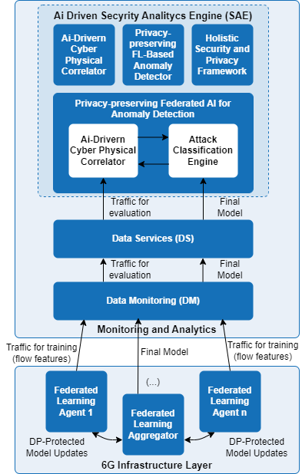
Advanced AI-Driven Anomaly detection, decision and mitigation strategies
Detection and prediction of network intrusions and anomalies
Multiple environments
  Industrial Control Systems (ICS)
  Network intrusion detection
  Network applications in containerized environment
Implementing hybrid FL techniques
  Sharing parameters and local models, not raw data
  Improving privacy
  Reduced training times
Using Privacy Enhancing Techniques (PETs)
  Zero-knowledge proofs, differential privacy,
  homomorphic encryption, multi-party computation

Slide 19
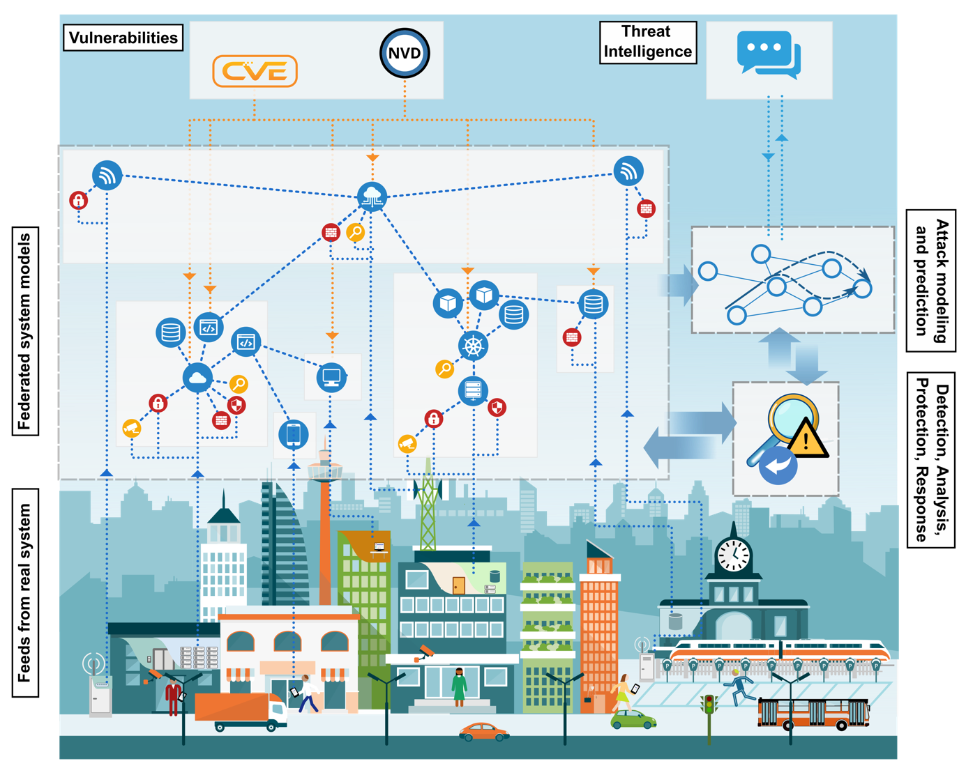
Cybersecurity Digital Twins
Digital Twins provide a virtual model of objects, systems, or processes
Application in multiple sectors
Enable analysis and protection of physical systems while minimizing impacts on production systems
Current Digital Service Chains (DSC) connect multiple devices and services heterogeneously
Multi-provider scenarios can open the 6G environment to vulnerabilities and attacks
Notes:
Smart cities have complex service supply chains with multiple devices and service providers.
Current Digital Service Chains are often complex, including multiple devices, data, infrastructures
This complexity can make the environment vulnerable to attacks, due to the difficulty of controlling the interactions between all providers

Slide 20
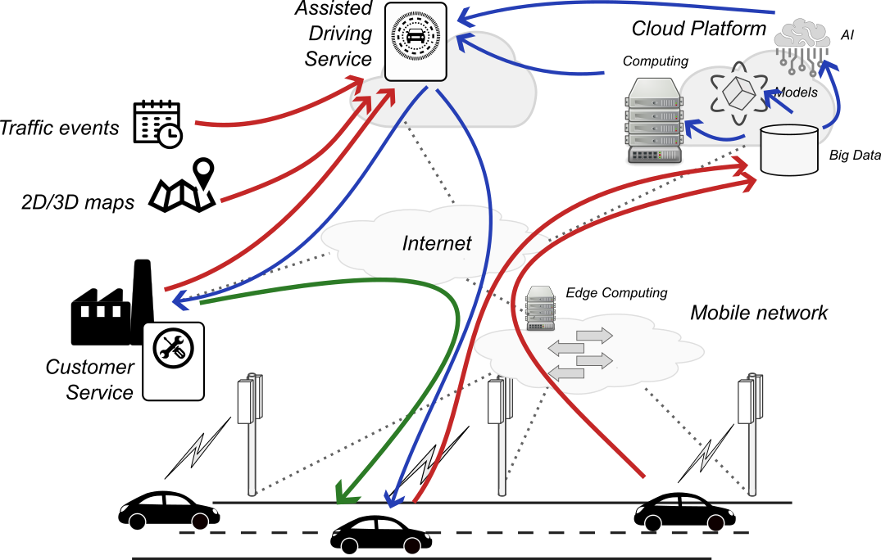
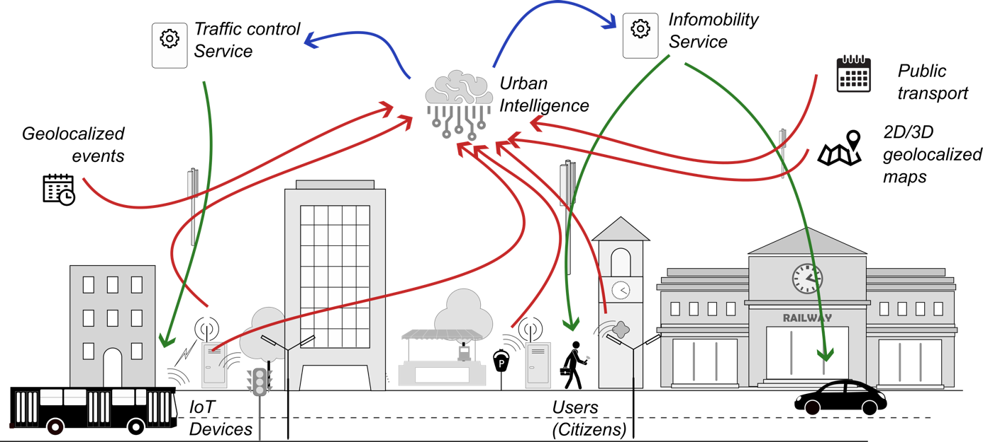
Cybersecurity Digital Twins
Address the complexity of interconnected systems
Understand the relationships between multiple providers
Identify root causes of attacks and predict their propagation
Suggest actions to mitigate threats
Notes:
Modelling the relationships between service providers.

Slide 21
Wrap up
Future 6G-enabled scenarios bring multiple opportunities
New and more complex services with multiple providers
360º security is required
Security-aware applications and service development
AI-based orchestration methods
Advanced AI-driven anomaly detection with data privacy awareness
Cyber Security Digital Twins modelling for threats analysis and mitigation planning
Notes:
Multiple environments to be secured (5/6G, Industrial control systems, smart cities, …)
Enforce DevSecOps to take security into consideration in all development phases
Ensure user data privacy when using FL techniques (include Privacy Enhancing Techniques – Zero-knowledge proofs, diferencial privacy, Homomorphic Encryption, Multi-Party Computation)
DT used to analyse the interactions of a multi-provider environment, find possible vulnerabilities to attacks and how they can propagate in the real scenario (foco especial em smart cities no MIRANDA)

Slide 22
Thanks
Follow us at:
https://rigourous.eu/
https://www.mirandaproject.eu/
Luis Cordeiro
cordeiro@onesource.pt
OneSource, Portugal

