Slide 1
Have you ever cared about the implications of digital interconnectedness?
Some thoughts on the issues behind cyber-security fragmentation in the interconnected digital space
Matteo Repetto
CNR-IMATI
Notes:
Hello everybody. In this pitch I’m going to share with you some thoughts about cyber-security fragmentation in interconnected digital ecosystems.

Slide 2


Think big!
Worried about feasibility…
Notes:
Today, business is a matter of continuous innovation and anticipation of market needs. If you want to stay ahead of competitors, you don’t have to get stuck with your current technologies and solutions, but you must be creative and think big. Of course, the main concerns are the feasibility of your ideas and the time to market.

Slide 3

Ehi! FIWARE is there for me!
Notes:
However, the prevailing business paradigms is no more in-house development and operation of the whole solutions, but there are plenty of applications, services, infrastructures, and even data out there that you can compose and use to implement your own solution. Data spaces and APIs ecosystems are growing all around, and it is always easier to find, select, and integrate them.

Slide 4
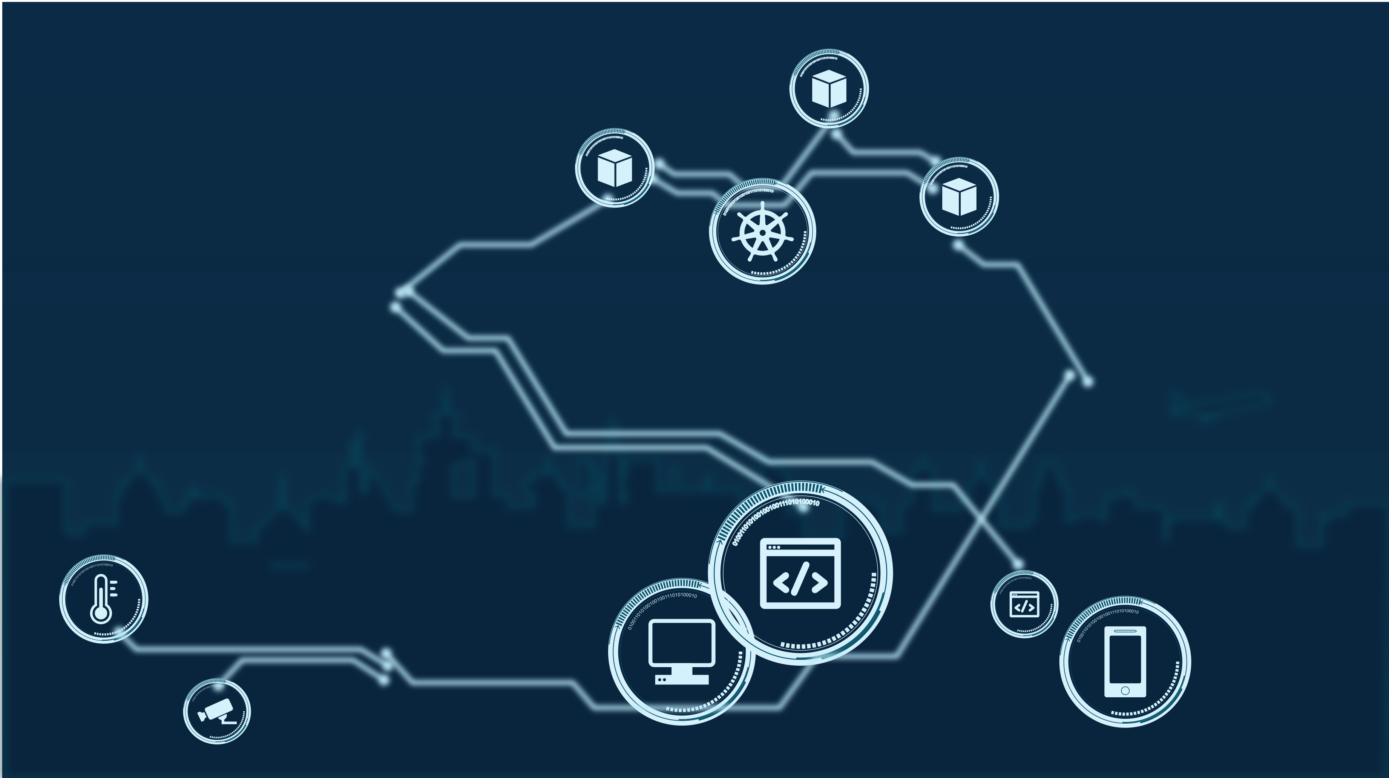
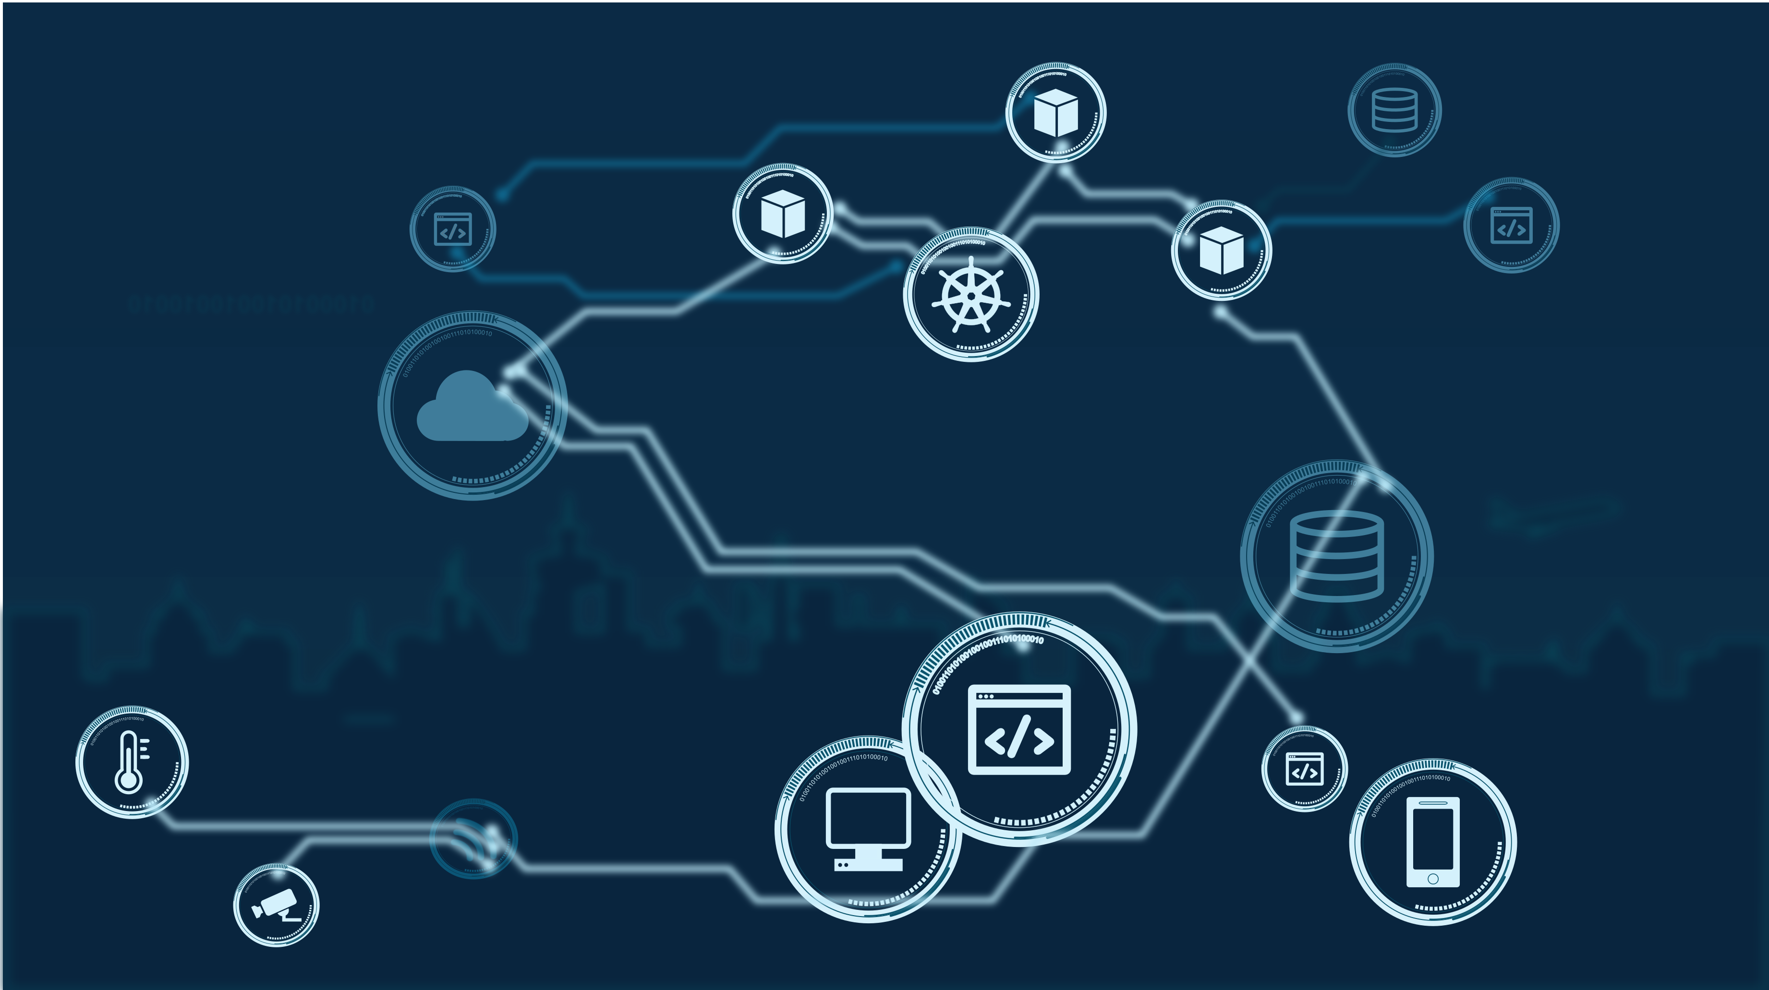

Quickly and well!
Notes:
Let’s suppose, for instance, you have in mind a new service in the smart city domain. You design your service, make an inventory of resources needed, and select providers that fulfil your expectations in terms of features, cost, reliability, quality, and whatever business or technical requirement is worth for you. You then get resources, configure and interconnect them so that they exchange data, make remote calls, run applications, etc.
THIS WAY YOU CREATE A SERVICE CHAIN!
Finally, you operate your service like you could directly manage all resources, at least to a large extent.
Of course, you are aware that there is something behind your control. This is the case, for instance, for cloud resources, where you don’t have access to the physical infrastructure and you share it with other tenants. This is a common business practice, and definitely you selected providers just because you trust them and the kind of service they give you. But… do you know the meaning and impact of “recursion???”

Slide 5
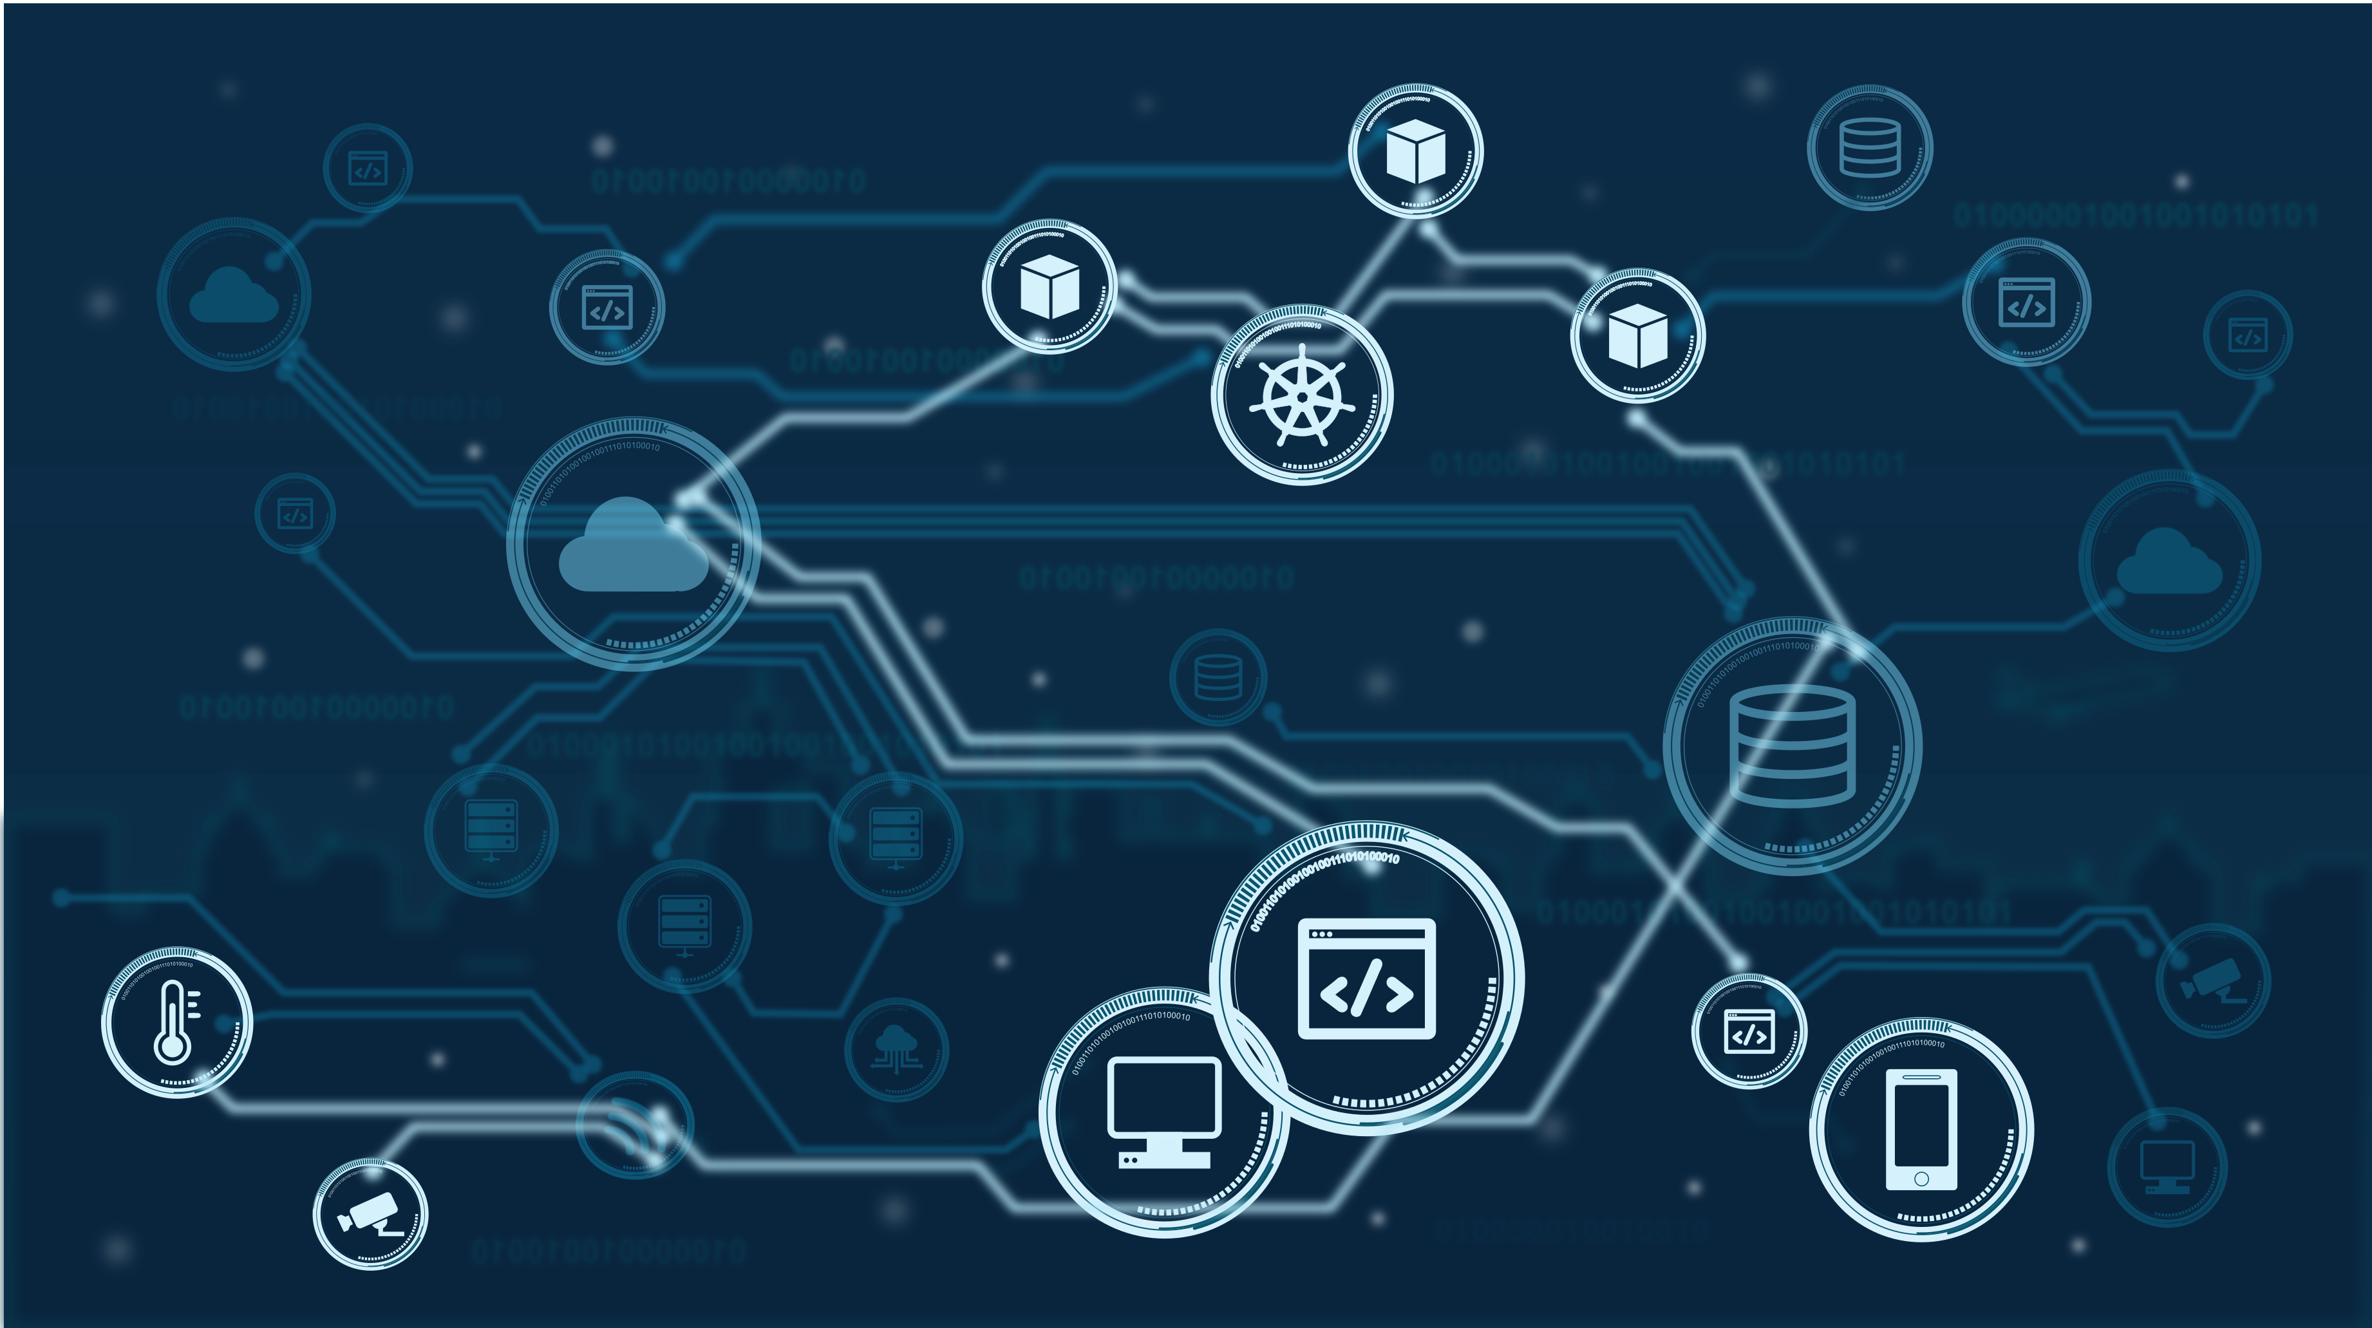
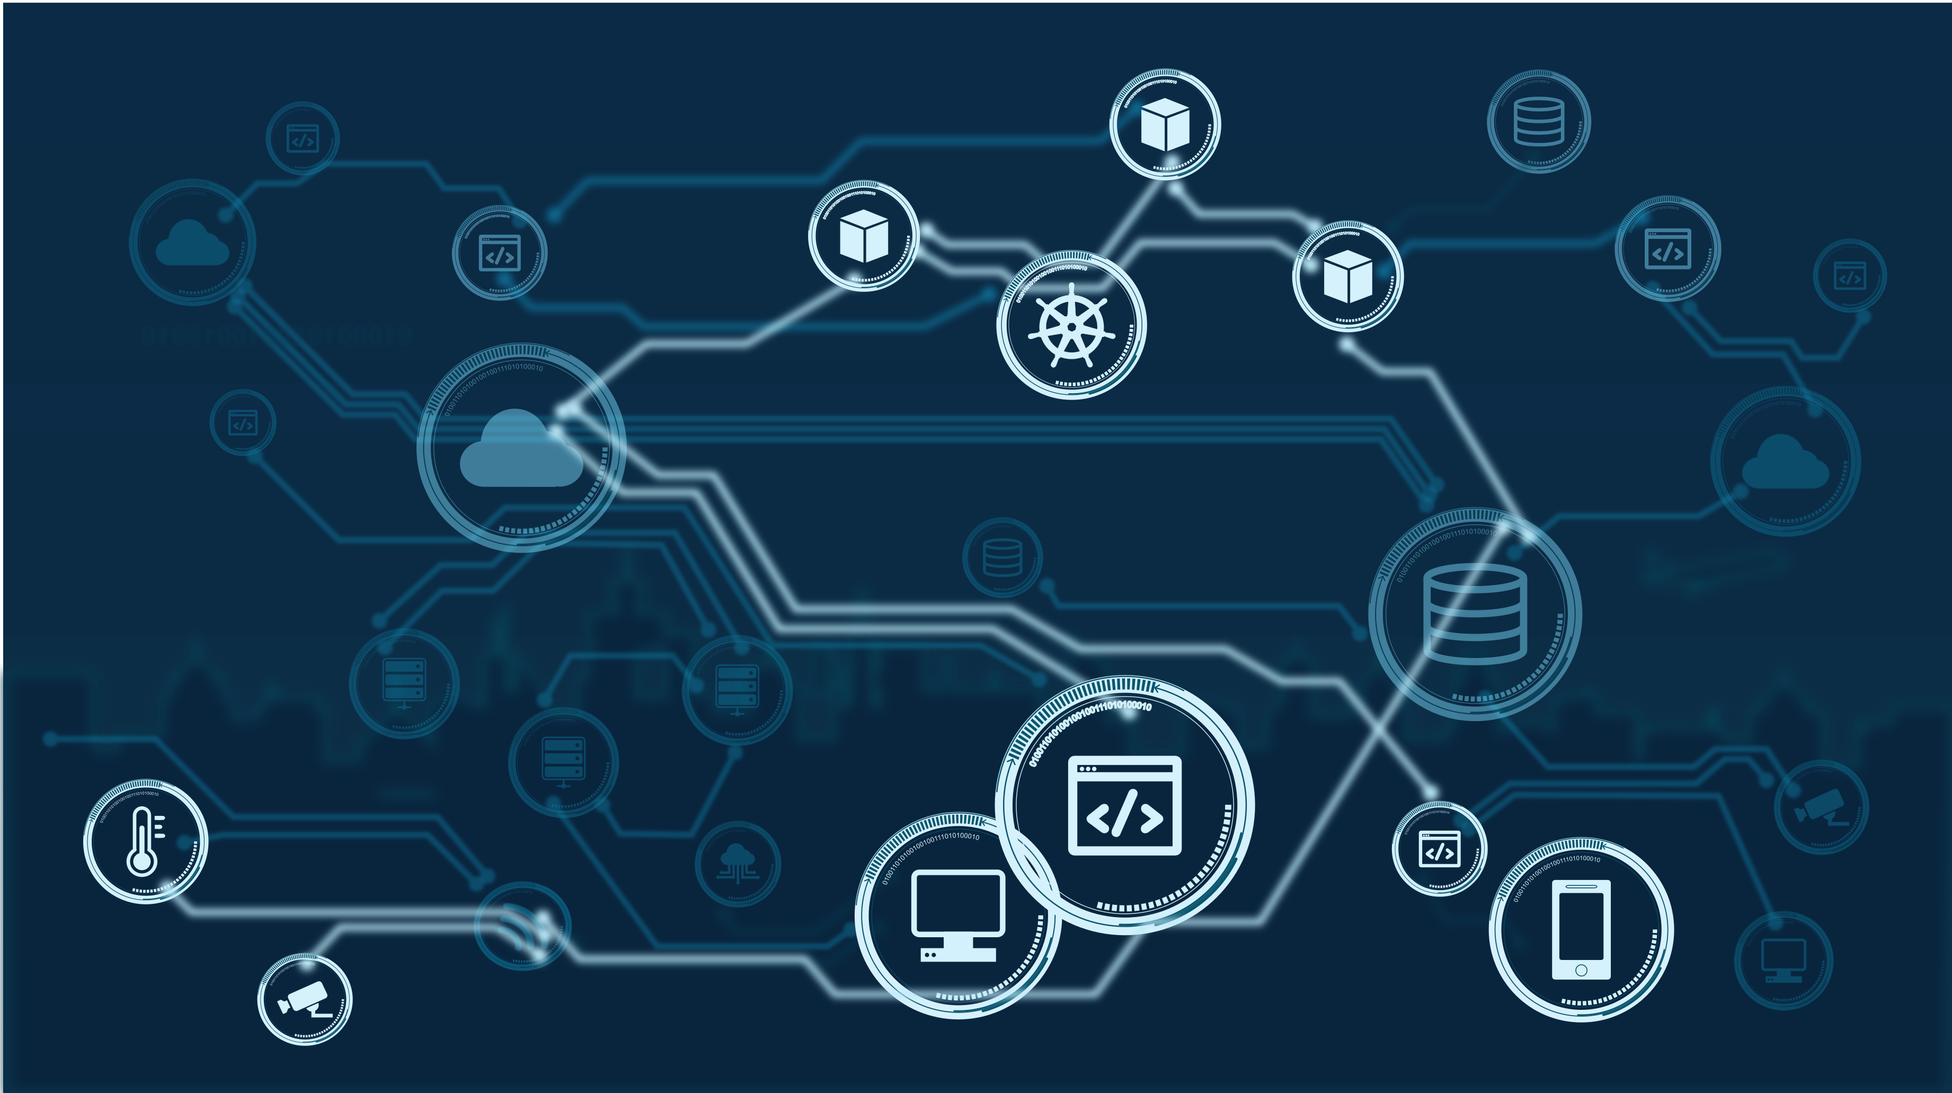

Feeling like something’s getting out of control…
but what?!?
Notes:
The same way you built your services with third parties’ resources, your providers likely do as well in turn. You are not aware of what there is behind your providers, and this might give you false confidence about the control you have and the security of your assets. The service chain is indeed much longer and complicated that what you expected, and indeed, it is not really a linear chain, but a mesh. And the unpleasant thing is that you don’t know it, or, better, you only know it partially. It may change over time, because different providers are selected or new services are deployed. It may grow. It may shrink. It may change topology and composition.

Slide 6
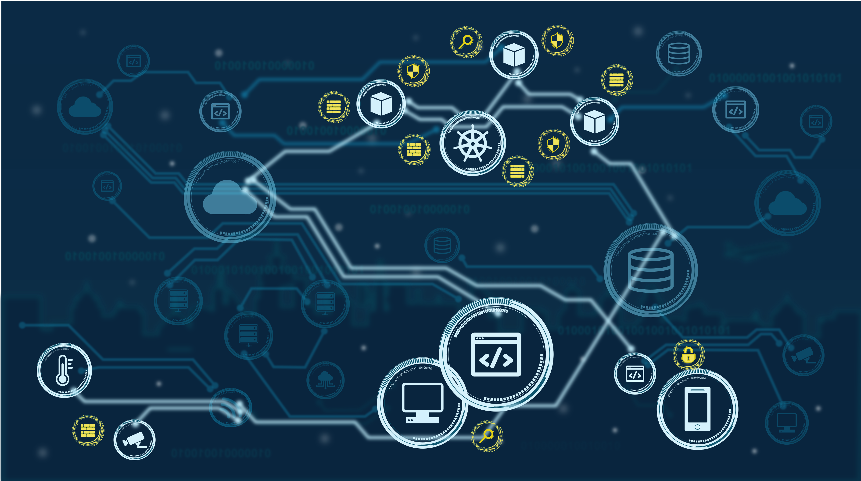

Ah-ah! Don’t forget security!
Notes:
But you are not unprepared! You deployed state-of-the-art security tools because you know the Internet remains unsafe and you must be prepared to tackle attacks coming all around you.
The are lots of monitoring, detection, and enforcement tools that are available on the market to create trust relationships and safely operate your services in interconnected environments.
So, you deployed all the necessary stuff to protect your assets…

Slide 7
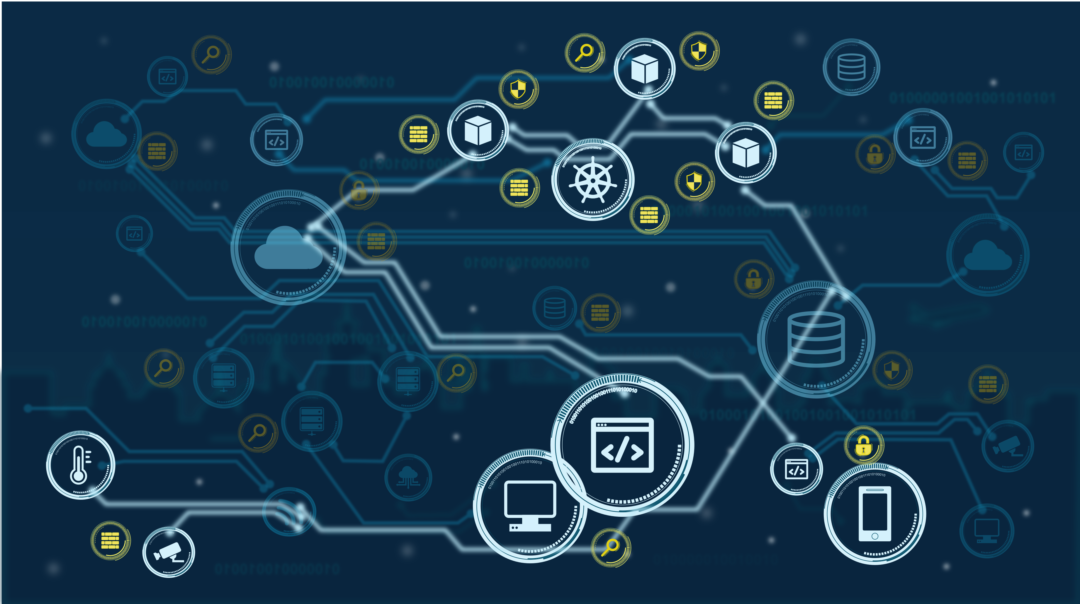




You out there! Why on earth are you sitting on your hands?!?
Notes:
… and the same did your providers. But… there is always a “but”!
Everyone works in isolation when interconnected to other services, and this is known to be the problem of fragmentation of cybersecurity operations.
Even if every provider has its own security controls in place, they do not care (or do not see) attacks against other domains.

Slide 8

You out there! Why on earth are you sitting on your hands?!?
Notes:
In this condition, the problem is that you can resist to attacks, you can mitigate them, but you cannot eradicate and stop them at their root!
This is a major problem, because such attacks might be destructive for you, even if they do not hit your services at their heart. This is a well know issue when DoS attacks saturate the internet link, or make anyway your service unavailable to your customers.
Despite of the great interoperability of operational APIs, we currently miss security APIs, which can effectively create collaborative cyber-security operations across domains. Overall, if we exchange data and use APIs to implement the business logic of our service, why shouldn’t we also create collaborative cybersecurity processes that automatically coordinate the response across the different domains and providers?

Slide 9
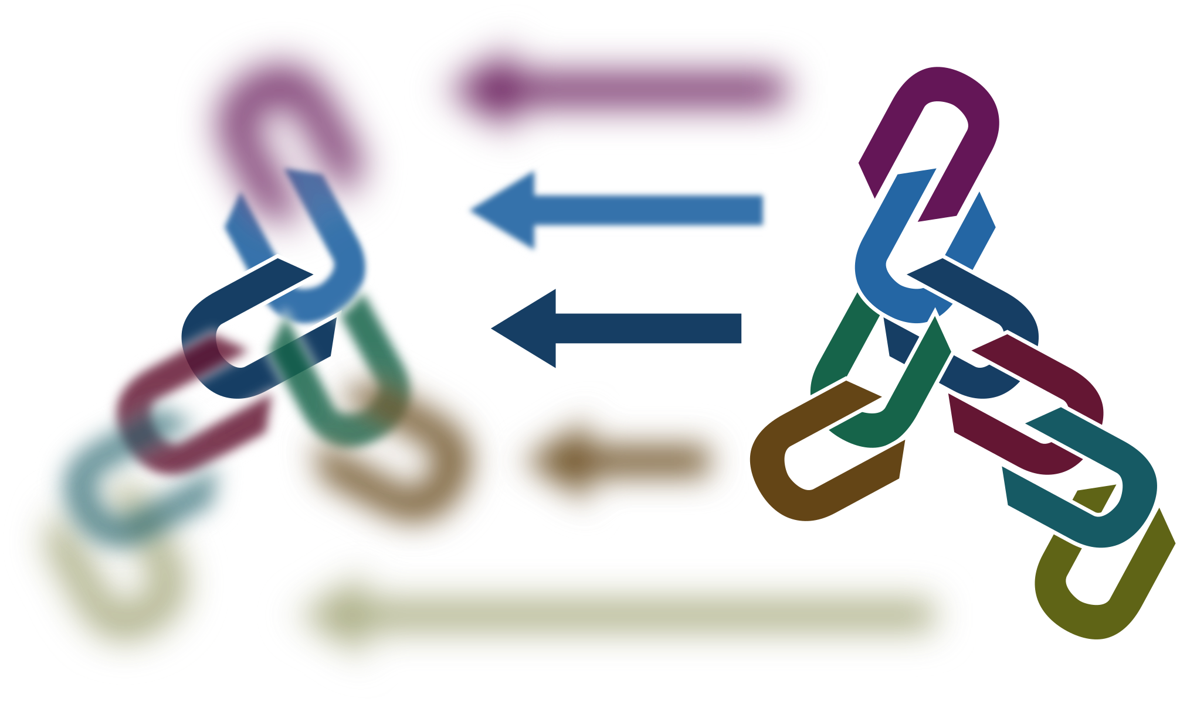


Sharing…
Chain twinning…
Opacity…
Notes:
Let’s think about this challenge… it’s not simple! The basic concept is to share a common view of the overall system, the service chain. Sharing is not enough, we must stay one step ahead of attackers and anticipate their movements. We need digital twins, namely models that are able to understand the current scenario, recognize attacks that propagate across domains, and predict their behavior. But wait… nobody will ever believe that providers are willing to give access to their internals! So, we need something more. This goes beyond plain trust, but involves something which is related to opaque visibility over domains, depending on the trust level, the business relationships in place, and… the current confidence in the integrity of the system.

Slide 10
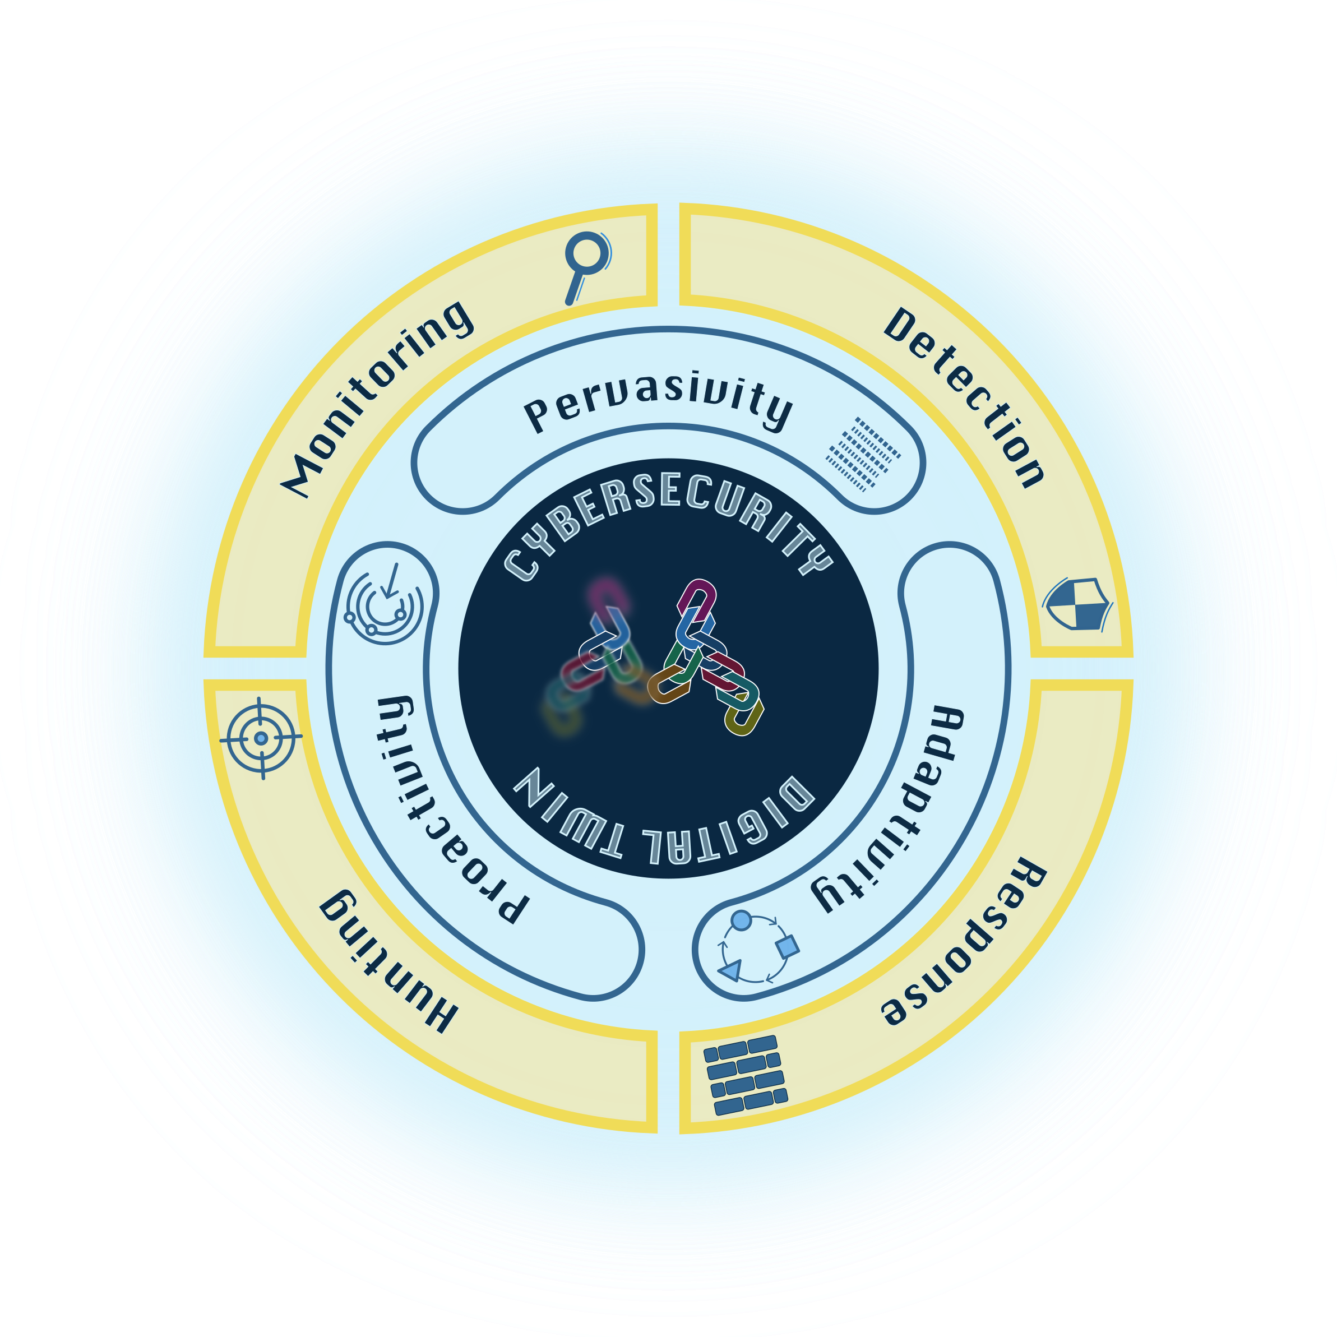
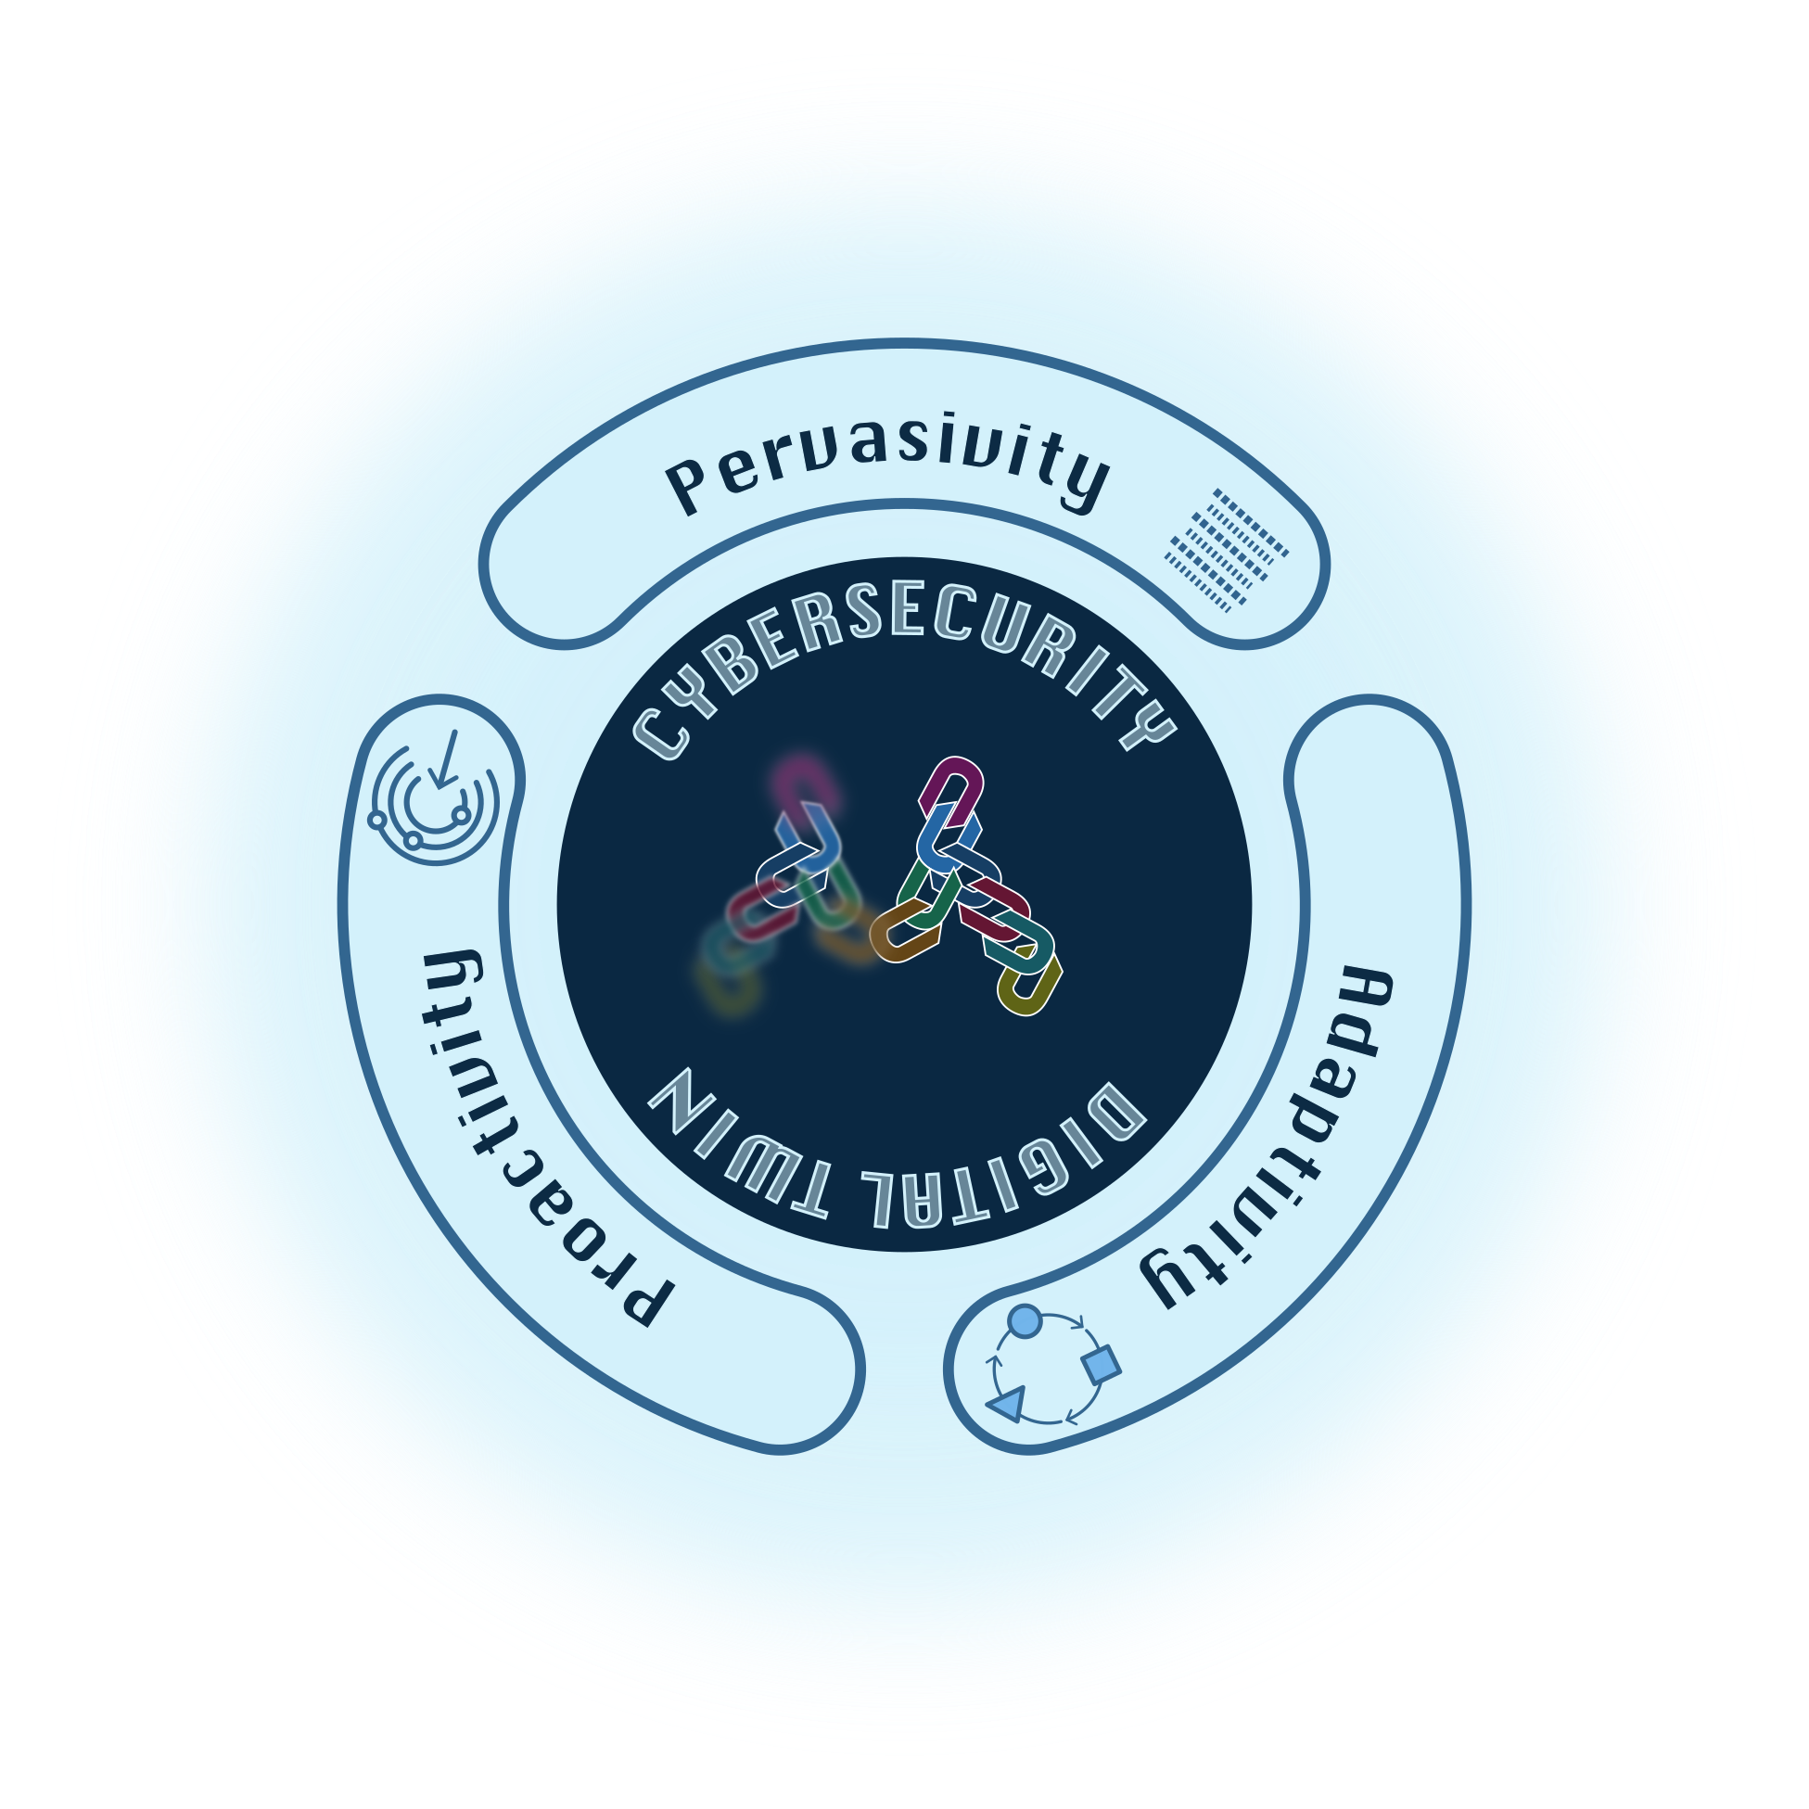
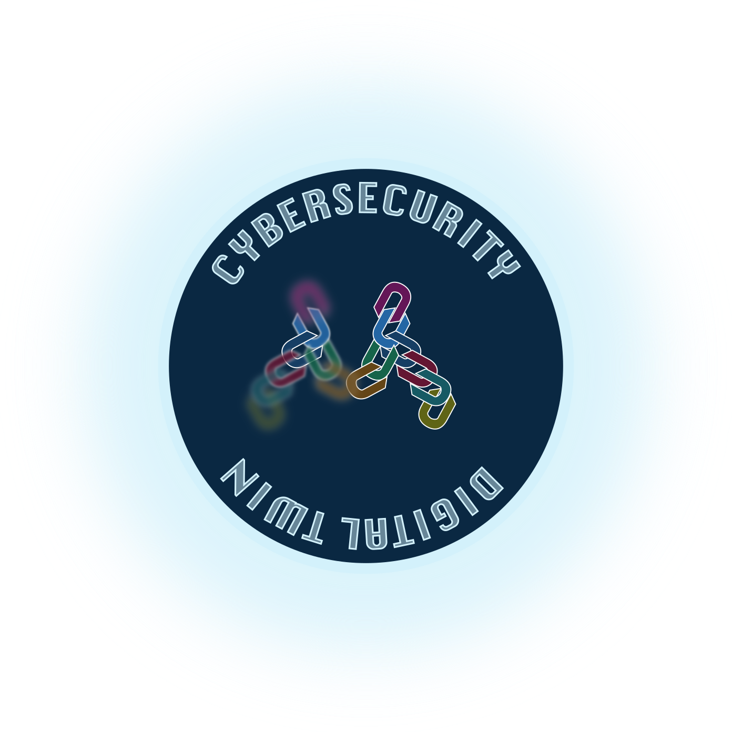

Notes:
So in our vision we need a digital twin, which is something more than a plain digital twin of the digital components that we can exercise with attack patterns. We need CYBERSECURITY digital twins, which include attack models that provide pervasive visibility, proactive identification of vulnerabilities and attacks, and adaptivity to ever-evolving environments. These three features will improve existing monitoring, detection, response, and hunting processes.
Indeed:
- pervasive monitoring across the whole chain (mediated by access control and opacity) will give improved visibility and awareness over the on-going scenario;
adaptive monitoring implies the ability to automatically derive parsers that adapts to new data formats (for instance, data logs and system metrics);
proactive detection is the ability to infer the evolution of attacks and the presence of new vulnerabilities and threats by matching known attack models to the underlying environment;
adaptive detection implies the ability to automatically adapt threat intelligence to similar scenarios, for instance to derive IoC from TTP;
pervasive response is somehow complementary to pervasive monitoring, and entails fine-grained controls scattered around the system, so to block or mitigate attacks as close as possible to their source;
adaptive response is again the ability to automatically derive playbooks and tailor them to evolving scenarios;
threat hunting is perhaps the most challenging aspect, implying the possibility to leverage the cybersecurity digital twin to make hypothesis and verify them without disrupting operations in the underlying system; it exploits a mix of predictive and adaptive capabilities to proactively understand how attackers can penetrate and move around the chain.

Slide 11

MIRANDA for FIWARE:
Security/context API
Threat prediction
Attack eradication
Federation & trust mgmt
Notes:
This is a challenging vision, but we are already working on it. The MIRANDA project is a recently-started EU project that aims at providing more collaboration and federation for security operations across digital service chains. It provides several benefits to the FIWARE world:
public APIs for managing context discovery and security controls across heterogeneous and, most of all, multi-ownership systems;
the ability to predict threat and their propagation around the whole system, not a single domain. You’re no more alone in tackling cyber-attacks, but you have the possibility to automatically interact with other domain to create the global picture, ask for remediation actions, and eradicate attacks at their origin;
federation and trust management are explicitly addressed by MIRANDA to create a trustworthy and safe collaboration environment. Federation builds on zero-trust architecture to address the dynamic and unpredictable nature of digital service chains; trust management is based on existing business relationships, reputation, and continuous integrity verification to create safe collaboration environments in all conditions.

Slide 12
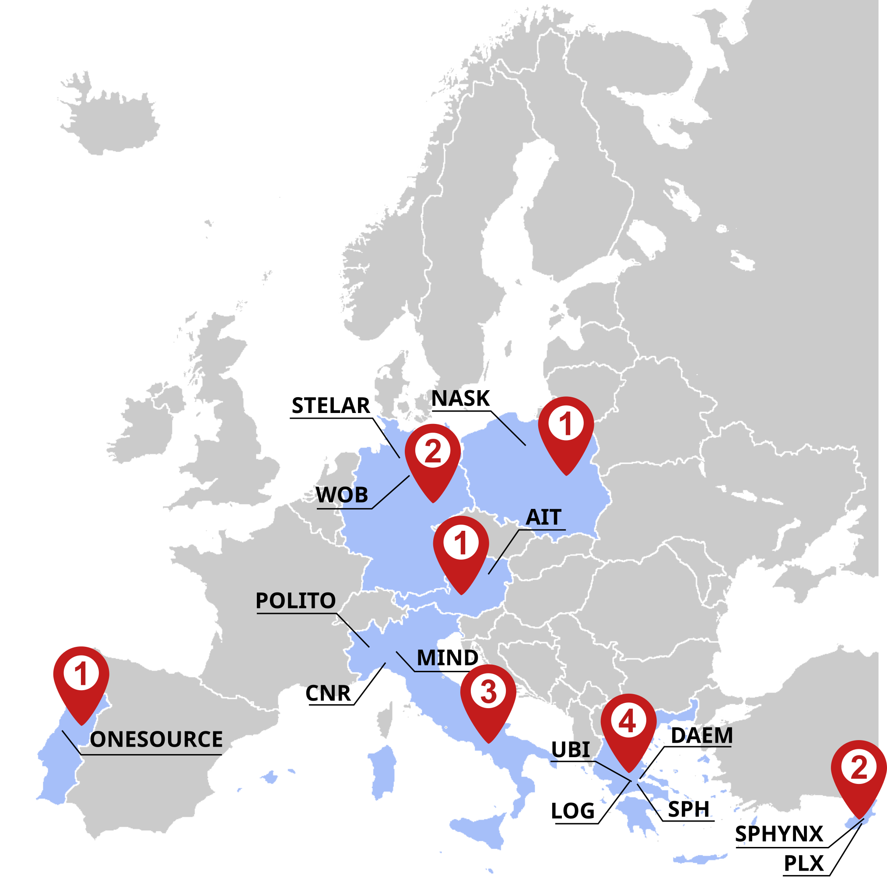








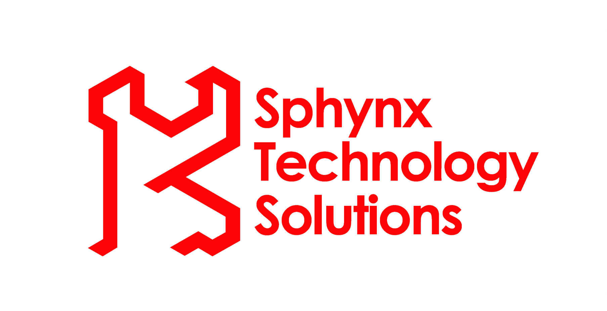
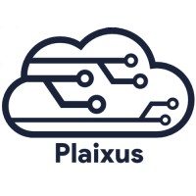



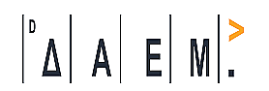
Project factsheet
Started: 1st September 2024
Duration: 36 months
Budget: 7 308 925.00 €
14 partners
3 Use Cases
  Wolfsburg, Genoa, Athens
Notes:
The MIRANDA project started on 1st September 2024 and will run for 3 years. With a budget of more than 7 millions euros and 14 partners, the Consortium will validate and demonstrate its technologies in 3 Use Cases in Wolfsburg, Genoa, and Athens. Both are smart cities applications made of multiple services and infrastructures. MIRANDA explicitly addresses the needs for security in multi-domain and multi-ownership systems, like those you can build with FIWARE technologies. This is why I’m here today to introduce you the MIRANDA project, and I hope we can feed a continuous dialogue during and even after this project.

Slide 13



Contacts
Thank you for you attention!
Project coordinator
  Matteo Repetto
  Institute for Applied Mathematics and Information Technologies (IMATI), CNR
  Genoa, Italy
  matteo.repetto@cnr.it
Questions?
info@mirandaproject.eu
www.mirandaproject.eu
@mirandaprj
Notes:
For more information about MIRANDA, we can contact me, the Project Coordinator, and follow us on our social media. They are just starting and still incomplete right now, but they will be soon populated with all useful content and news in the following weeks.
I just conclude with the take-away message of my talk: be aware of cyber-security implications behind interconnectedness. Security is a global and collaborative matter today, and you cannot fight alone right the same way you cannot develop the whole components of your application from scratch. Be prepared to integrate cybersecurity APIs in your digital services and products. We’re pursuing standardization as an enabler of our ecosystem.

